Slide 1
Welcome to the world of UNIX
Subhasis Samantaray

Slide 2
CONTENTS
Unix Operating System
Kernel
Shell
User login process
Basic Unix commands
File management
Directory management
Permission
File/Text processing commands
VI editor
Pattern searching
Searching and Archiving
Process management
Job Scheduling
Disk usage commands
Architecture of Unix File system
Mailing commands/Utilities
Networking commands
Printing commands
Arithmetic operations
Some useful commands
Misc commands

Slide 3
Unix Operating System
Shell
Kernel
Hardware
In UNIX, the operating system is broken into three pieces: the kernel, the shell, and the built-in utilities. The kernel is responsible for low level hardware communication, the shell provides human users with a user-friendly interface, and the built-in utilities provide basic tools for doing work.

Slide 4
Kernel
Heart of The Unix OS.
Collection of C programs directly communicating with hardware
Part of Unix system loaded into memory when Unix is booted
Manages:-
System resources
Allocates time between user and processes
Decides process priorities

Slide 5
Shell
Human interface point for Unix
Program layer – provides an environment for the user to enter commands to get desired results.
Korn Shell, Bourne Shell, C Shell are various shells used by Unix users

Slide 6
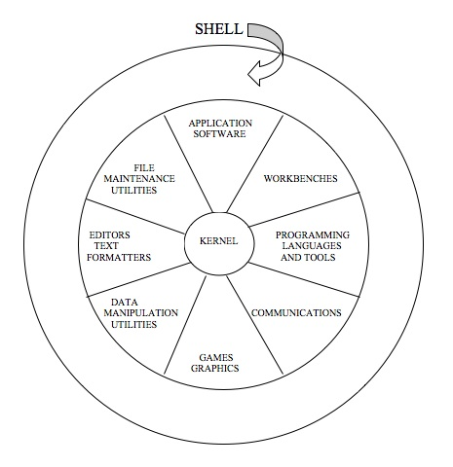

Slide 7
User login process
Unix booted.
Program Unix(kernel) is booted into main memory, and remains active till the computer is shut down
Program init runs as a background task and remains running till shutdown
User attempts to log in.
Kernel calls program ‘init’.
‘init’ scans file /etc/inittab , which lists the ports with terminals and their characteristics and returns an active open terminal to ‘init’.
‘init’ calls program ‘getty’, which issues a login prompt in the monitor
User enters login and password

Slide 8
User login process
‘getty’ calls program ‘login’ which scans file /etc/passwd to match username and password
After validation, control passes to session startup program /bin/sh , session startup program
Program /bin/sh reads file /etc/profile and .profile and sets up system wide and user specific environment.
User gets a shell prompt

Slide 9
Basic Unix commands
-Login
-Change password ( Passwd )
-Check the date and time (date)
-Check the present working directory (pwd)
-Check the teminal ( tty & stty)
-Check the system uptime ( uptime)
-Check the user details (finger)
-Change the user details (chfn)
-Get the details of current loggedin users ( Who,Whoami,w )
-Get the identification details ( id )
-Check the name and flavour of the OS ( uname )
-Check the calendar ( Cal )
- Banner (banner)
-host name ( hostname )
-domain name (domainname,dnsdomainname,nisdomainname,ypdomainname )
-clear ( To clear screen )

Slide 10
passwd
passwd command is used to update/change user’s authentication token(s).
Root user can change/reset the password for other users .
In production environment generally password expires in 90 days or after 1 year.

Slide 11
date
date command is used to print or set the system date and time
Syntax: date +”<options>”
Some useful options :
%b locales abbreviated month name (Jan..Dec)
%d day of month (01..31)
%D date (mm/dd/yy)
%F same as %Y-%m-%d
%H hour (00..23)
%I hour (01..12)
%m month (01..12)
%M minute (00..59)
%S second (00..60)
%T time, 24-hour (hh:mm:ss)
%y last two digits of year
%Y year (1970...)

Slide 12
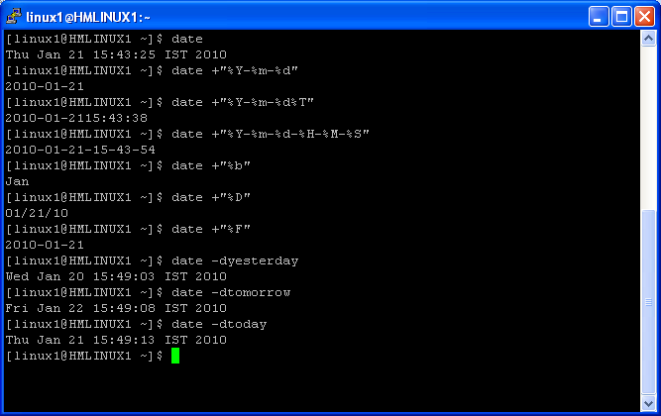
Date - Example

Slide 13
pwd,tty,stty,uptime,finger
pwd command is used to print name of current/working directory
tty command is used to print the file name of the terminal connected to standard input
stty command is used to change and print terminal line settings
stty –a command is used to print all current settings in human-readable form
uptime - Tell how long the system has been running.
finger command is used to check the user information

Slide 14
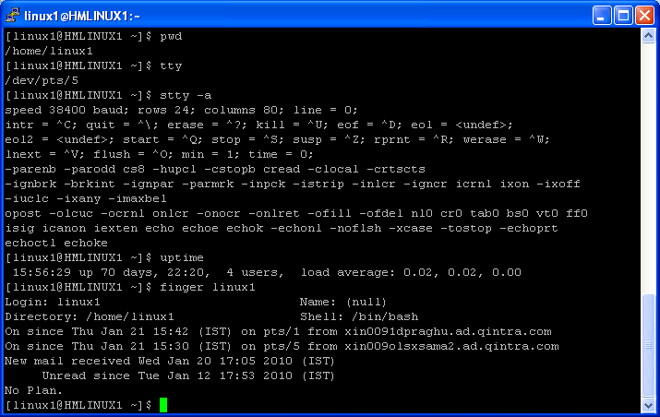
Example : pwd,tty,stty,uptime,finger

Slide 15
chfn,who
chfn - change your finger information
who - show who is logged on
Some useful options of who command :
-b time of last system boot
-i add idle time as HOURS:MINUTES
-r print current runlevel
-u list users logged in

Slide 16
Run levels
The runlevels used by RHS are:
0 - halt (Do NOT set initdefault to this)
1 - Single user mode
2 - Multiuser, without NFS (The same as 3, if you do not have networking)
3 - Full multiuser mode
4 - unused
5 - X11
6 - reboot (Do NOT set initdefault to this)

Slide 17
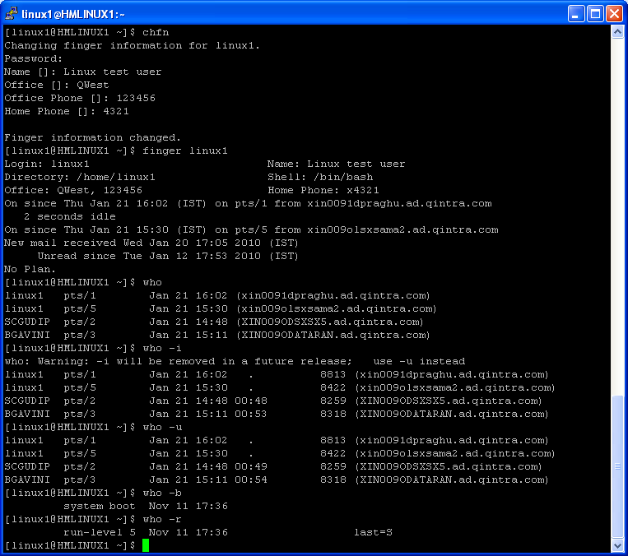
Example : chfn,who

Slide 18
whoami,w,id
whoami - print effective userid
w - Show who is logged on and what they are doing.
id - print real and effective UIDs and GIDs
Some useful options of id command :
-g print only the effective group ID
-G print all group IDs
-n print a name instead of a number

Slide 19
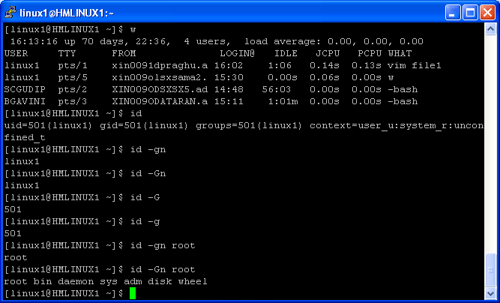
Example : whoami,w,id

Slide 20
uname,cal,clear
uname - print system information
Some useful options of uname comand :
-a print all information
-n print the network node hostname
-r print the kernel release
-v print the kernel version
-m print the machine hardware name
-p print the processor type
cal - displays a calendar
Cal displays a simple calendar. If arguments are not specified, the current month is displayed.The options are as follows:
-1 Display single month output. (This is the default.)
-3 Display prev/current/next month output.
-s Display Sunday as the first day of the week. (This is the default.)
-m Display Monday as the first day of the week.
clear - clear the terminal screen

Slide 21
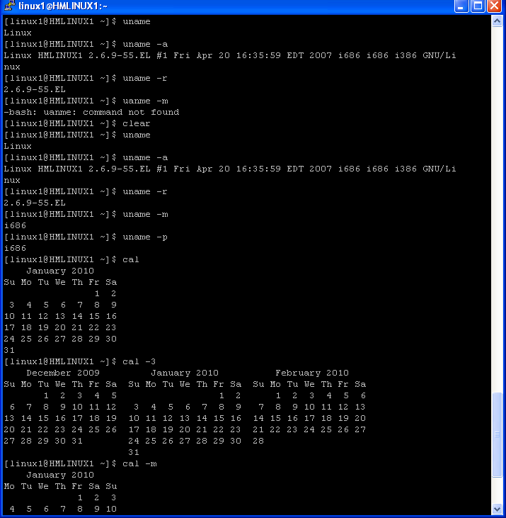
Example : uname,cal,clear

Slide 22
hostname, domainname , dnsdomainname , nisdomainname , ypdomainname
hostname - show or set the system’s host name
Some useful options of hostname command :
-s short host name
-a alias names
-i addresses for the hostname
-f long host name (FQDN)
-d DNS domain name
-y NIS/YP domainname
domainname - show or set the system’s NIS/YP domain name
dnsdomainname - show the system’s DNS domain name
nisdomainname - show or set system’s NIS/YP domain name
ypdomainname - show or set the system’s NIS/YP domain name

Slide 23
Questions ???
How to get the OS name ?
How to know since when the server is up ?
How to get the last boot time of server ?
How to get the details of user ?
How to know who all are currently logged in and which program they are executing currently ?
How to get the current date and time ?
How to get yesterday’s date ?
How to get tomorrow’s date ?
How to print the date in the following format ?
Todays date is : YYYY-mm-dd:HH-MM-SS
10) How to change the users information ?
11) How to get the id of a particular user ?
12) How to know the present working directory ?
13) How to know which terminal is associated with your current session ?
14) How to get the current terminal settting details ?
15) How to see the calendar of March 1999 ?
16) How to see the calendar for the year 1992 ?
17) How to get the hostname ?
18)How to get the FQDN (Fully Qualified Domain Name) ?

Slide 24
How to set arrow keys and backspace ?
Setting arrow keys :
Set the keys as per terminal types …
set -o emacs
case "$TERM" in
xterm*|dec-vt220|vt100)
alias __A=^P
alias __B=^N
alias __C=^F
alias __D=^B
;;
hpterm|hp|700*)
alias _A=^P
alias _B=^N
alias _C=^F
alias _D=^B
esac
Set backspace as erase character :
stty erase ^?

Slide 25
File management
- Create a file ( cat ,touch )
- Append contents to the file ( >> )
- Redirection
- Indirection
- Here document
- Nullify the contents
- List the file(s) ( ls )
- copy ( cp )
- Use indirection to copy the file contents .Eg cat >Destn <Source
- Rename ( mv )
- delete ( rm )
-Link (ln , link ,unlink)
tac - concatenate and print files in reverse

Slide 26
cat
cat - concatenate files and print on the standard output
To create a file :
cat >filename
After entering the text ,Press [ ctrl + d ] to save and exit
To append new contents to a existing file :
cat >>filename
After entering the text ,Press [ ctrl + d ] to save and exit
Redirection Example :
Let you want to redirect the output of cal command to cal.out file .
cal >cal.out
To see the contents of cal.out :
cat cal.out

Slide 27
cat
Indirection example :
Let Qwest.txt is a existing file .You want to cretate a new file WMAIP.txt which will have the same contents as Qwest.txt .
cat > WMAIP.txt < Qwest.txt
( This is equivalent to : cp Qwest.txt WMAIP.txt)
Here document example :
cat >example.txt<<EOF
Enter test
.
.
EOF
( After specifying EOF at the last ,Hit enter )
Some useful options of cat command :
-b number nonblank output lines
-n number all output lines

Slide 28
cat command
Commands | Significance
cat >file1 | Creates file file1 where a user enters text and presses <Ctrl-D> to end text editing
cat >>file1 | Append lines to existing content of file : file1 and is ended when <Ctrl-D> is pressed
cat file1 | Shows the contents of the file: file1
cat file1>file2 | Copies the contents of file : file1 into new or existing file : file2
cat file1 file2 > file3 | Concatenates the content of file1 and file2 and places it into new or existing file file3
cat file1 >>file2 | Appends the contents of file1 after the last line of file2. If file2 does not exist, new file is created

Slide 29
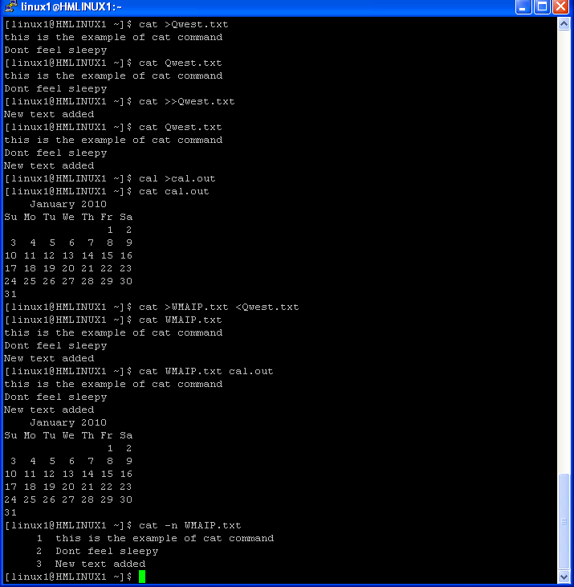
Example : cat ( create,append,redirection,indirection)

Slide 30
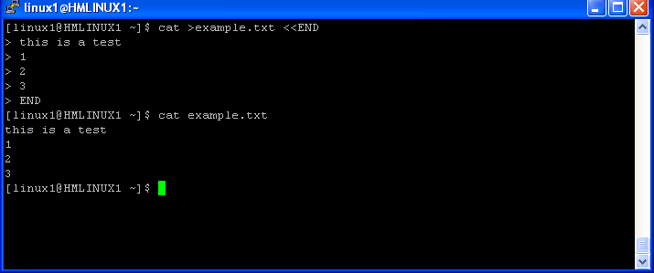
Example : Here document

Slide 31
touch
touch – create blank file ,change file timestamps( access time,modification time)
Some useful options :
-a change only the access time
-c do not create any files
-m change only the modification time
-t use [specified time] instead of current time
To create a blank file :
touch <filename>
To change the access time :
touch –at ‘YYYYMMDDHHMM’ <filename>
To change the modification time :
touch –mt ‘YYYYMMDDHHMM’ <filename>

Slide 32
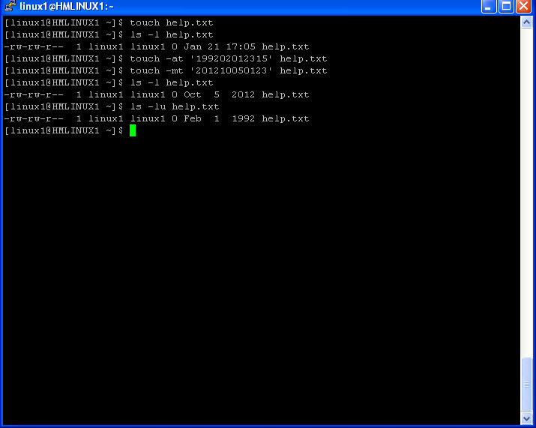
Example : touch

Slide 33
Nullify the contents,Create blank file in different ways
To nullify the file use :
cat /dev/null >filename
>file name
To create a blank file you can use :
touch filename
cat /dev/null >filename
>filename
cat > filename [ Immediately press ctrl+d to save and exit ,it will create a blank file ]
To create a hidden file we need to specify . Before the file name
cat >.filename
touch .filename

Slide 34
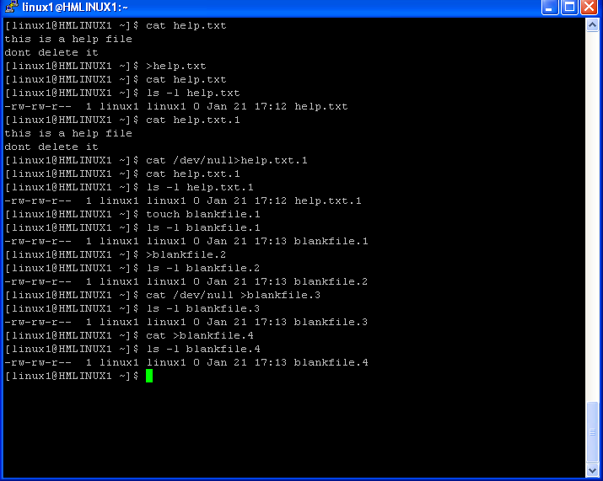
Example : Nullify the contents,Create blank file in different ways

Slide 35
List the file(s) : ls
ls - list directory contents
List information about the FILEs (the current directory by default). Sort entries alphabetically if none of the options specified
Some useful options of ls command :
-a do not hide entries starting with .
-C list entries by columns
-d list directory entries instead of contents, and do not dereference symbolic links
-F append indicator (one of */=@|) to entries
-g like -l, but do not list owner
-G inhibit display of group information
-h print sizes in human readable format (e.g., 1K 234M 2G)
-i print index number of each file
-l use a long listing format
-r reverse order while sorting
-R list subdirectories recursively
-s print size of each file, in blocks
-S sort by file size
-t sort by modification time
-u with -lt: sort by, and show, access time with -l: show access time and sort by name otherwise: sort by access time
-1 list one file per line

Slide 36
Output of ls -li
1) Inode : Physical location of file
2) Type :
The mode displayed with the -e and -l flags is interpreted as follows:
If the first character is:
d The entry is a directory.
b The entry is a block special file.
c The entry is a character special file.
l The entry is a symbolic link, and either the -N flag was specified or the symbolic link did not point to an existing file.
p The entry is a first-in,first-out (FIFO) special file.
s The entry is a local socket.
- The entry is an ordinary file.
3) Permission :
The next nine characters are divided into three sets of three characters each. The first set of three characters show the owner’s permission. The next set of three characters show the permission of the other users in the group. The last set of three characters shows the permission of anyone else with access to the file. The three characters in each set indicate, respectively, read, write, and execute permission of the file. Execute permission of a directory lets you search a directory for a specified file. Permissions are indicated as follows:
r Read
w Write (edit)
x Execute (search)
Corresponding permission not granted
The group-execute permission character is s if the file has set-group-ID mode. The user-execute permission character is s if the file has set-user-ID mode. The last character of the mode (usually x or -) is T if the 01000 (octal) bit of the mode is set (see the chmod command for the meaning of this mode).

Slide 37
Output of ls -li
4) Link count
5)Owner
6)Group
7)Size of the file
8)Time stamp ( Month day time or year month day )
9) File name

Slide 38
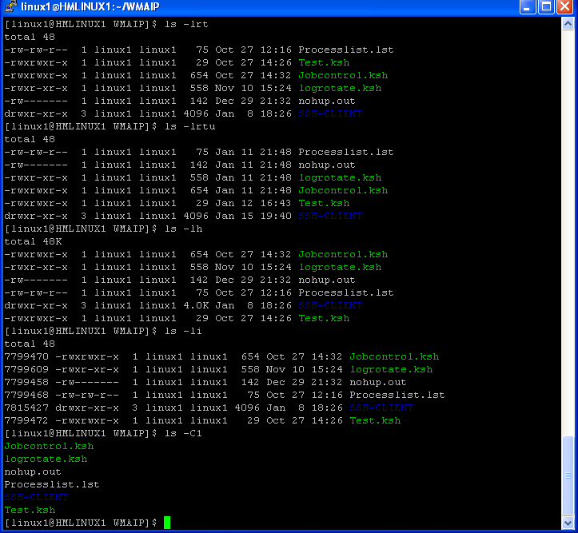
Example : ls

Slide 39
Copy (cp)
cp - copy files and directories
Some useful options :
-f if an existing destination file cannot be opened, remove it and try again
-i prompt before overwrite
-l link files instead of copying
-p same as --preserve=mode,ownership,timestamps
-R copy directories recursively
-r copy directories recursively
-s make symbolic links instead of copying
-u copy only when the SOURCE file is newer than the destination file or when the destination file is missing

Slide 40
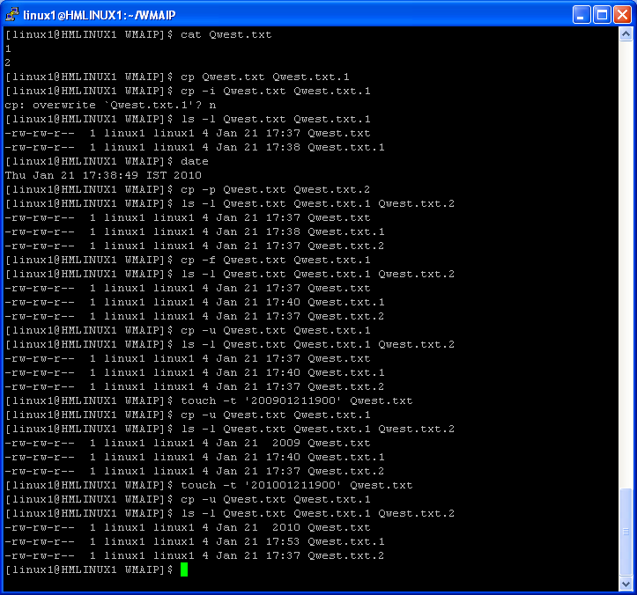
Example : Copy (cp)

Slide 41
Rename : mv , Delete :rm
mv - move (rename) files
Rename SOURCE to DEST, or move SOURCE(s) to DIRECTORY.
mv [OPTION]... SOURCE DEST
mv [OPTION]... SOURCE... DIRECTORY
Useful options of mv command :
-f do not prompt before overwriting
-i prompt before overwrite
-u move only when the SOURCE file is newer than the destination file or when the destination file is missing
rm - remove files or directories
Useful options of rm command :
-f ignore nonexistent files, never prompt
-i prompt before any removal
-r remove the contents of directories recursively
-R remove the contents of directories recursively
To remove a file whose name starts with a - , for example -Qwest , use one of these commands:
rm -- -Qwest
rm ./-Qwest

Slide 42
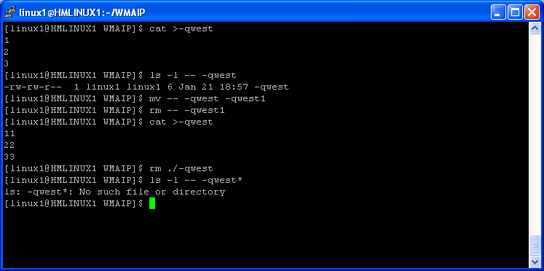
Example : Rename : mv , Delete :rm

Slide 43
Links : Hard Link and Symbolic Link (Soft link )
ln - make links between files
Useful options of ln command :
-f remove existing destination files
-i prompt whether to remove destinations
-s make symbolic links instead of hard links
Hard Link :
A link file created with the Linux / Unix ln command that points to a file's inode.
- Childs are not dependant on parent.
Inode numbers will be the same
We cant create hard link to directories.
Symbolic Link:
Also known as a soft link or symlink, a symbolic link is a Linux / Unix file created with the ln command that links to another file using the path. Unlike a hard link, a symbolic link can link to any file on any computer.
- Childs are dependant on parent. If you will remove the the source/parent file ,the child file or link will be dangled.
Inode numbers are different
We can create soft/symbolic link to directories.

Slide 44
Links : Hard Link and Symbolic Link (Soft link )
To create symbolic link to a file :
ln –s sourcefile newlink
To create symbolic link to a directory :
ln –s sourcedir newlink
To create hard link :
ln sourcefile newlink
You can use cp command with –l option to create a hardlink.
cp –l sourcefile newlink
You can use cp command with –s option to create a soft link/symbolic link.
cp –s sourcefile newlink
link, unlink - link and unlink files and directories
The link and unlink commands link and unlink files and directories. Only super-users can use these commands on directories.
$ link A.s A.s.1
$ ls -li A.s*
7800612 -rw-rw-r-- 2 linux1 linux1 79 Jul 20 18:30 A.s
7800612 -rw-rw-r-- 2 linux1 linux1 79 Jul 20 18:30 A.s.1
$ unlink A.s.1
$ ls -li A.s*
7800612 -rw-rw-r-- 1 linux1 linux1 79 Jul 20 18:30 A.s

Slide 45
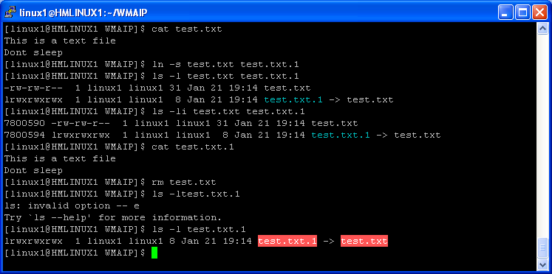
Example : Symbolic link or soft link

Slide 46
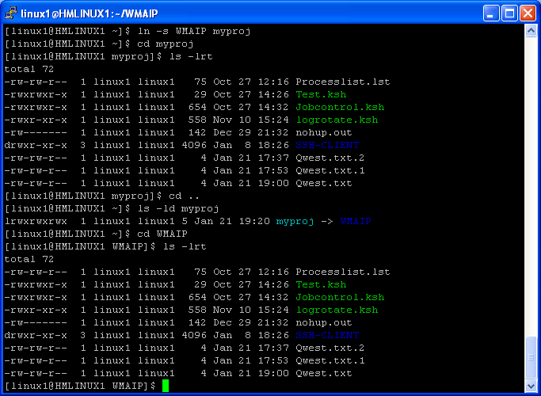
Example : Symbolic link or soft link to directories

Slide 47
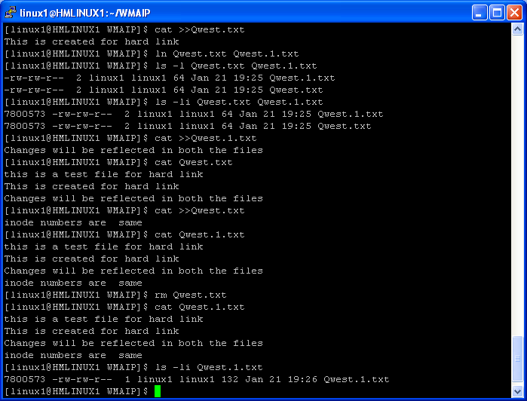
Example : Hard Link

Slide 48
Questions ???
1) Cretate a file using cat command ? What is the difference ctrl+d and ctrl+c ( when you are using the ctrl keys to save and exit )??
2) How to append contents to a existing file?
3) How to change the modification time of a file ?
4) Change the modification time of Qwest.ext file as 1999-Oct-10 23:25 if it exists !!
5) How many ways you can create a blank file ?
6) Cretate file “ My documents” ?
7) Create a file –filename . List ,rename and delete the same file .
8) What is the difference between hard link and soft link ?
9) How to get the inode number of the file ?
10) Explain the output of ls –li .
11) How to get the access time and modfication time of a file ?
12)How to get the file size in kb,mb,gb ??
13)How to list the contents of a directory in a single column ?
14)How to create a hidden file and how to list the file ?
15)How to copy a file with the existing time stamp of source file ? i.e : time stamp of source and destination file should be the same ..
16)Explain indirection,Redirection,Here document .
17)Explain Link count field .( output of ls –l command ) ?
18) How to copy a file without using cp command ?
19) How to create a hard/soft link to a file without using ln command ?
20)What is link and unlink command ?

Slide 49
Directory management
- Create directory ( mkdir )
- Rename directory (mv)
- Remove/Delete the directory ( rmdir ,rm -f ,rm -rf )
- Change directory ( cd ,cd ~ ,cd $HOME ,cd / ,cd .. ,cd . ,cd - ,cd ../.. etc )
- copy file(s) from/to a directory
- Move file(s) from/to a directory
-Link (ln)

Slide 50
Create directory ( mkdir )
mkdir - make directories
Create the DIRECTORY(ies), if they do not already exist.
Some useful options of mkdir comamnd :
-p no error if existing, make parent directories as needed.
-m set permission mode

Slide 51
Create directory ( mkdir )
To create a directory :
mkdir DIR_NAME
To crete a directory including parent dir
mkdir –p /DIR/STRUCTURE/
To create a directory with specific permissions:
mkdir –m <***> DIRNAME
*** : Permission in octal equivalent ( eg: 700 ,770,777 )

Slide 52
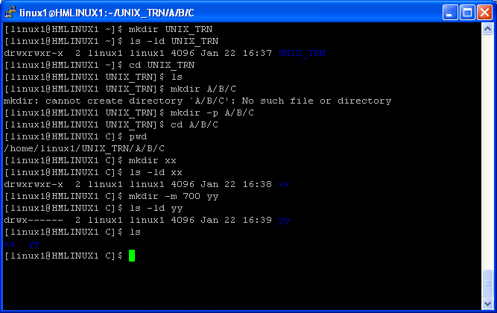
Example : Create directory ( mkdir )

Slide 53
Rename (mv) , Remove/Delete ( rmdir ,rm -rf ) the directory
mv - move (rename)
Rename SOURCE to DEST, or move SOURCE(s) to DIRECTORY.
Some useful options of mv comand :
-i prompt before overwrite
-u move only when the SOURCE file is newer than the destination file or when the destination file is missing
-f do not prompt before overwriting
Syntax :
mv <SOURCE> <DEST>
mv </SOURCE/*.exm > </DEST/>
rm - remove files or directories
rm –rf : Remove the non empty directory ( recursively and forcefully ).
rmdir - remove empty directories
rmdir –p - remove DIRECTORY, then try to remove each directory component of that path name.
E.g., rmdir -p a/b/c is similar to rmdir a/b/c a/b

Slide 54
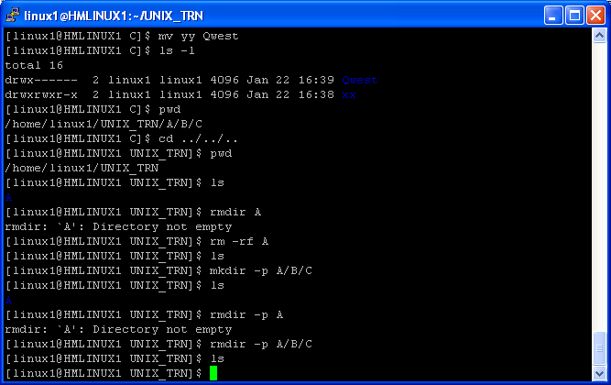
Example : Rename (mv) , Remove/Delete ( rmdir ,rm -rf ) the directory

Slide 55
Change directory ( cd ,cd ~ ,cd $HOME ,cd / ,cd .. ,cd . ,cd - ,cd ../.. etc )
cd – To change the directory
To go back to the home directory :
cd ~
cd $HOME
cd
cd ~user [ user : currently logged in user ]
To go to root ( / ) directory
cd /
To go to one directory back :
cd ..
To go to two directory back :
cd ../../
To go to three directory back:
cd ../../../

Slide 56
Change directory ( cd ,cd ~ ,cd $HOME ,cd / ,cd .. ,cd . ,cd - ,cd ../.. etc )
To go back to the previous working directory :
cd –
To go to the any users home directory :
cd ~usename
Analyse the output of the following command :
echo $PWD
echo $OLDPWD

Slide 57
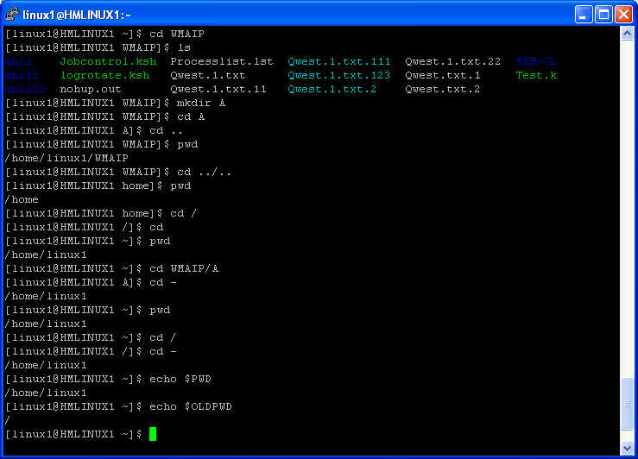
Example : Change directory ( cd ,cd ~ ,cd $HOME ,cd / ,cd .. ,cd . ,cd - ,cd ../.. etc )

Slide 58
Copy file(s) from/to a directory
Copy file(s) from/to a directory :
cp <filename> <Path of dir>
cp </Path/of/sourcefile> ./
Example :
cp Qwest.txt ./A/B/
cp *.txt ./A/B/
To copy the whole directory structure
cp –R </Path/of/Dir/*> </Path/of/Destn/>
Example :
cp –R ./Qwest/* ./Qwest_bkp/

Slide 59
Move file(s) from/to a directory
Move file(s) to a directory :
mv <filename> <Path of dir>
mv </path/of/sourcefile/> ./
To rename a directory :
mv SOURCE_DIR DESTN_DIR
Example :
mv Qwest.txt ./A/B/
mv *.txt ./A/B/
mv ./A/B/*.txt ./
mv Qwest Qwest_bkp

Slide 60
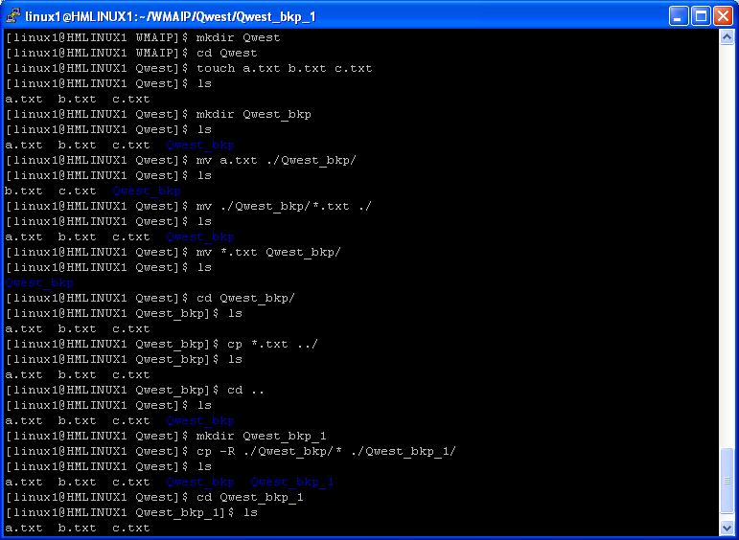
Example :

Slide 61
Example : Symbolic link or soft link to directories
To create symbolic link to a directory : ln –s sourcedir newlink

Slide 62
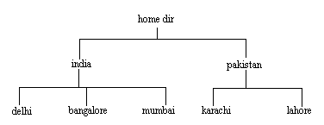
- Observe the present working directory
Create the above directory structure .Let you are in your home directory .Don’t use cd while creating the directory structure.
Create files india1 and india2 under india , delhi1 and delhi2 under delhi and likewise under all other directories.
Change the directory from home to bangalore.
Copy file bangalore1 from bangalore to karachi.
Change directory to india from bangalore.
Move file delhi1 to mumbai.
List the contents of mumbai from current directory which is india.
Copy all files bangalore1 and bangalore2 from bangalore to lahore with a single command.
View the contents of lahore from india.
- Go back to your home directory and try to open the file using absolute path .
Change the directory to delhi ,Now try to list the pakistan directory using relative path and absolute path .
Try to access/read the files present under pakistan directory using relative path and absolute path .

Slide 63
Questions ??
How to create a directory ?
Create the directory structure : A/B/C/D ?
Create directory “Qwest” with permission 700 ?
Rename the directory Qwest to Qwest_bkp ?
Create a directory WMAIP inside Qwest .
Copy the Whole Qwest directory to Qwest_bkp ?
Explain cd - ? How it works ?
How to go back to home directory ?
How to copy a directory recursively ?
How to remove a non empty directory ?
How to remove a empty directory ?
How to create a link to a directory ?
How to go to the root directory ?
How to go to other user’s home directory ?
Explain mkdir –p and rmdir –p ?
Explain about the following SHELL variables :
HOME ,PWD,OLDPWD
Create a directory –Qwest ?
Remove the directory –Qwest ?
19) How to create a hidden directory ?
20) What is absolute path and relative path ?
21) Try to create a directory under / ( root ) drectory .Notice the error message .

Slide 64
Permission
- Owner,group and others
- Octal/Numeric representation
- read,write,Execute permissions
- Default permission
- umask value
- change permission of file or directory ( chmod )
- Change group (chgrp)
- Change owner (chown)

Slide 65
The chmod command modifies the mode bits and the extended access control lists (ACLs) of the specified files or directories. The mode can be defined symbolically or numerically.
Symbolic Mode :
To specify a mode in symbolic form, you must specify three sets of flags. Note: Do not separate flags with spaces.The first set of flags specifies who is granted or denied the specified permissions, as follows:
u File owner.
g Group.
o All others.
a User, group, and all others. The a flag has the same effect as specifying the ugo flags together. If none of these flags are specified, the default is the a flag and the file creation mask (umask) is applied.
The second set of flags specifies whether the permissions are to be removed, applied, or set:
- Removes specified permissions.
+ Applies specified permissions.
= Clears the selected permission field and sets it to the permission specified. If you do not specify a permission following =, the chmod command removes all permissions from the selected field.
The third set of flags specifies the permissions that are to be removed, applied, or set:
r Read permission.
w Write permission.
x Execute permission for files; search permission for directories.
s Set-user-ID-on-execution permission if the u flag is specified or implied. Set-group-ID-on-execution permission if the g flag is specified or implied.
t For directories, indicates that only file owners can link or unlink files in the specified directory. For files, sets the save-text attribute.

Slide 66
Examples:
To add a type of permission to several files:
chmod g+w chap1 chap2
This adds write permission for group members to the files chap1 and chap2.
2. To make several permission changes at once:
chmod go-w+x mydir
This denies group members and others the permission to create or delete files in mydir (go-w) and allows group members and others to search mydir or use it in a path name (go+x). This is equivalent to the command sequence: chmod g-w mydir chmod o-w mydir chmod g+x mydir chmod o+x mydir
3. To permit only the owner to use a shell procedure as a command:
chmod u=rwx,go= cmd
This gives read, write, and execute permission to the user who owns the file (u=rwx). It also denies the group and others the permission to access cmd in any way (go=). If you have permission to execute the cmd shell command file, then you can run it by entering: cmd

Slide 67
Numeric representation of permissions
Value | Significance
4 | Read permission
2 | Write permission
1 | Execute permission
6(=4+2) | Read and write permission
7(=4+2+1) | Read,write and execute permission
5(=4+1) | Read and execute permission
To recursively descend directories and change file and directory permissions use –R option .
Example : chmod –R 777 ./example/*

Slide 68
chmod - change file access permissions
Syntax: chmod <val1><val2><val3> <filename(s)|directory name(s)>
val1 is for users
val2 is for group
val3 is for others
Any permission on a directory percolate down to the files and sub-directories under it.
Example | Significance
chmod 744 file1 | Grant all permissions to : User, and read permission to group and others
chmod 776 | Grant all permission to user and group, read and write permission to others
chmod 777 file1 | Grant all permission to all

Slide 69
Few more Examples:
chmod u+x myfile
Gives the user execute permission on myfile.
chmod +x myfile
Gives everyone execute permission on myfile.
chmod ugo+x myfile
Same as the above command, but specifically specifies user, group and other.
chmod 400 myfile
Gives the user read permission, and removes all other permission.
These permissions are specified in octal, the first char is for the user, second for the group and the third is for other.
chmod 764 myfile
Gives user full access, group read and write access, and other read access.
chmod 751 myfile
Gives user full access, group read and execute permission, and other, execute permission.
chmod +s myfile
Set the setuid bit.
chmod go=rx myfile
Remove read and execute permissions for the group and other.

Slide 70
Default file/directory permission ,umask
Default permission for directory is 777 .
Default permission for file is 666 .
The default umask 0002 used for normal user. With this mask default directory permissions are 775 and default file permissions are 664.
The default umask for the root user is 0022 result into default directory permissions are 755 and default file permissions are 644.
To check the umask value execute :
umask

Slide 71
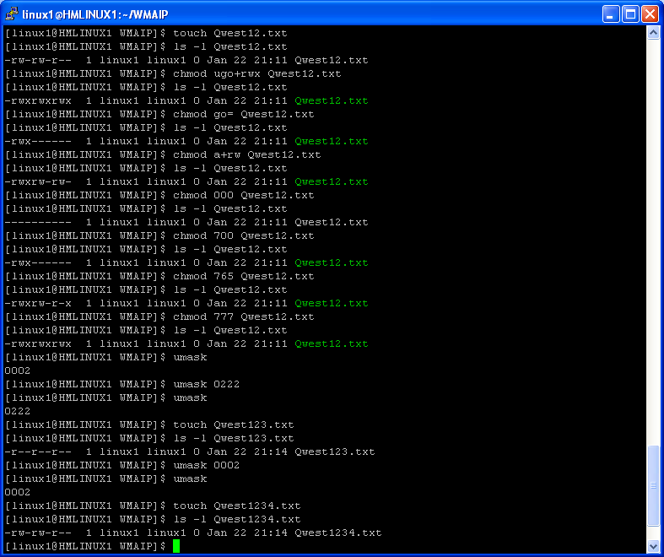
Example :chmod ,umask

Slide 72
chgrp, chown, chgrp
chgrp - change group ownership
chown - change file owner and group
Example :
chown subhasis test1
Changes the owner of the file test1 to the user subhasis.
chgrp subhasis test1
Changes the file test1 to belong to the group “subhasis".
Go through the man pages to get more information on chgrp ,chown,acl .

Slide 73
To use Set-ID Modes:
chmod ug+s cmd
When the cmd command is executed, the effective user and group IDs are set to those that own the cmd file. Only the effective IDs associated with the child process that runs the cmd command are changed. The effective IDs of the shell session remain unchanged. This feature allows you to permit access to restricted files. Suppose that the cmd program has the Set-User-ID Mode enabled and is owned by a user called dbms. The user dbms is not actually a person, but might be associated with a database management system. The user betty does not have permission to access any of dbms’s data files. However, she does have permission to execute the cmd command. When she does so, her effective user ID is temporarily changed to dbms, so that the cmd program can access the data files owned by the user dbms. This way the user betty can use the cmd command to access the data files, but she cannot accidentally damage them with the standard shell commands.
When run Unix executables can use the effective rights of a different user or group. This is shown by having an 's' rather than 'x'. For example:
ls -l /bin/su
-rwsr-xr-x 1 root root 60820 Oct 4 2006 /bin/su
When su is run it runs with the same rights as the user root.
Any program which is suid or sgid must be written very carefully to make sure that it can not be abused by malicious users to do things they shouldn't.

Slide 74
The sticky bit - /tmp directory
Normally (without 't') any user who has write permission to a directory can delete any files in the directory regardless of who owns it, even if they can't read or write to the file.
With 't' set, only the owner of a file can delete it.
This is used on /tmp
ls -ld /tmp
drwxrwxrwt 9 root root 4096 Jan 22 21:31 /tmp
To set the sticky bit on a directory :
chmod +t directory
To remove the sticky bit from a directory :
chmod -t directory

Slide 75
Questions ??
What is the default directory permission ?
What is the default file permission ?
What is the default umask value ?
How to change the umask value ?
How umask value plays the role in changing the permission ?
Let I want to set the umask value as 0077 permanently .What are the steps to do it ? After the set up what will be the directory and file permissions ?
How to change the group of a file/directory ?
How to change the owner of the file or directory ?
Set the following permission to Qwest.txt
user : read,write
group:read
others: none
Set the permission in 2 ways .
10) Explain the octal representation ?
11) What is set id mode ?
12) What is sticky bit ?How to set sticky bit ?
13) How to revoke sticky bit ?
14) Cretate a directory Qwest_EX with 600 permission ,then try to cd to that directory and analyse the error message .
Let you are the owner of a directory .The directory permission is 600 .Will you able to list the contetnts ?
How many ways we can grant read,write,execute permission to all on Qwest.txt ( Qwest.txt is text file ) ?
What is the default permission for symbolic link(s) ?Can we change the permission of symbolic links ?
What will happen if you change the permission of symbolic/soft link (s) ?
19) Let in a directory you have 30 regular text files and 5 symbolic/soft links and 10 directories . Recursively change the permission of regular files and directories to 700 without any change to linked files .

Slide 76
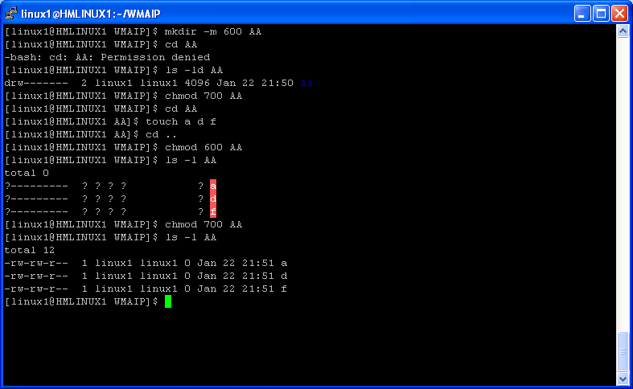
Strange output : ☺

Slide 77
File/Text processing commands
- head
- tail
- pg
- more
- less
- cut
- paste
- tr
- sort
- uniq
- comm
- cmp
- diff
- sdiff
- join
- col
- seq
- wc

Slide 78
head,tail
head - output the first part of files
By default it prints the first 10 lines of each FILE to standard output.
To print the first 30 lines of file Qwest.txt :
head -30 Qwest.txt
tail - output the last part of files
By default it prints the last 10 lines of each FILE to standard output.
tail –f : to check the run time growth of the file

Slide 79
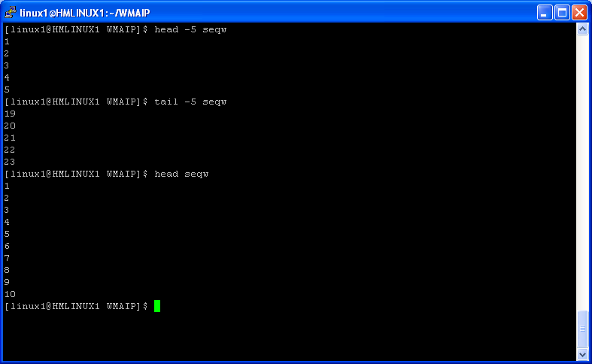
Example : head,tail

Slide 80
pg
pg - files perusal filter for CRTs
The pg command is a filter that allows the examination of
filenames one screenful at a time on a CRT. If the user
types a RETURN, another page is displayed; other possibili-
ties are listed below.
This command is different from previous paginators in that
it allows you to back up and review something that has
already passed. The method for doing this is explained
below.
To determine terminal attributes, pg scans the terminfo(4)
data base for the terminal type specified by the environment
variable TERM. If TERM is not defined, the terminal type
dumb is assumed.

Slide 81
more,less
more - file perusal filter for crt viewing
more -p Do not scroll. Instead, clear the whole screen and then display the text.
more -num This option specifies an integer which is the screen size (in lines).
more -s Squeeze multiple blank lines into one.
less - opposite of more
less --help

Slide 82
cut
cut - remove sections from each line of files
Some useful options of cut command :
-c output only these characters
-d use DELIM instead of TAB for field delimiter
-f output only these fields; also print any line that contains no delimiter character, unless the -s option is specified
-s do not print lines not containing delimiters

Slide 83
Example : cut
[linux1@HMLINUX1 WMAIP]$ cat Qwest.txt
1:Anil:SE:Qwest
2:Srikanth:LEAD:Qwest
3:Subhasis:SSE:Qwest
4:Sudipta:Manager:Qwest
[linux1@HMLINUX1 WMAIP]$ cat Qwest.txt|cut -c1
1
2
3
4
[linux1@HMLINUX1 WMAIP]$ cat Qwest.txt|cut -d":" -f2
Anil
Srikanth
Subhasis
Sudipta
[ [linux1@HMLINUX1 WMAIP]$ cat Qwest.txt|cut -d":" -f2-4
Anil:SE:Qwest
Srikanth:LEAD:Qwest
Subhasis:SSE:Qwest
Sudipta:Manager:Qwest
[linux1@HMLINUX1 WMAIP]$ cat Qwest.txt|cut -d":" -f1,3
1:SE
2:LEAD
3:SSE
4:Manager
[linux1@HMLINUX1 WMAIP]$ cat Qwest.txt|cut -d":" -f1,3,2
1:Anil:SE
2:Srikanth:LEAD
3:Subhasis:SSE
4:Sudipta:Manager

Slide 84
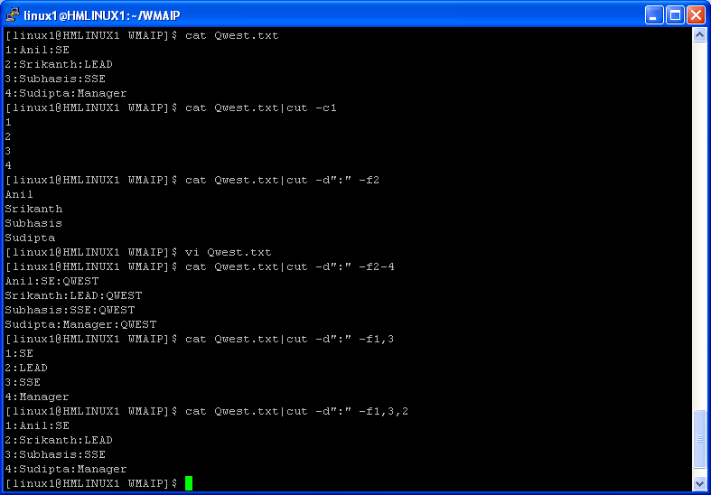
Example : cut

Slide 85
paste
paste - merge lines of files
Write lines consisting of the sequentially corresponding lines from each FILE, separated by TABs, to standard output. With no FILE, or when FILE is -, read standard input.
-d reuse characters from LIST instead of TABs
-s paste one file at a time instead of in parallel

Slide 86
Example : paste
[linux1@HMLINUX1 WMAIP]$ cat Qwest.txt
1:
Anil
2:
Srikanth
3:
Subhasis
[linux1@HMLINUX1 WMAIP]$ paste -s -d' \n' <Qwest.txt >Qwest.out
[linux1@HMLINUX1 WMAIP]$ cat Qwest.out
1: Anil
2: Srikanth
3: Subhasis
[linux1@HMLINUX1 WMAIP]$ cat Qwest.1.txt
:SE
:LEAD
:SSE
[linux1@HMLINUX1 WMAIP]$ paste Qwest.out Qwest.1.txt
1: Anil :SE
2: Srikanth :LEAD
3: Subhasis :SSE

Slide 87
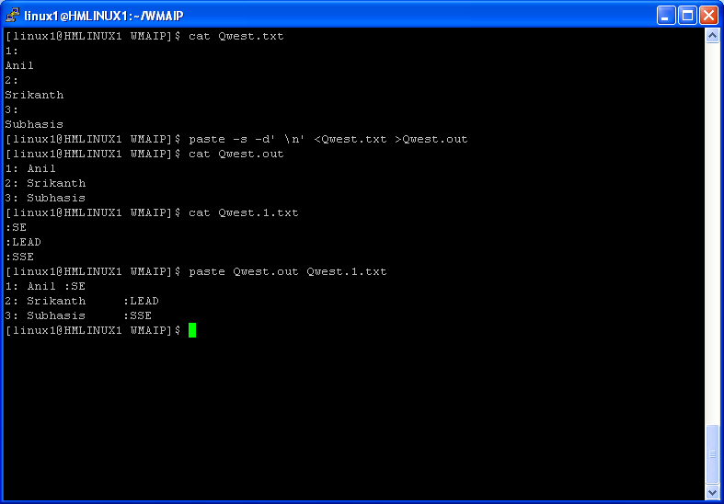
Example : paste

Slide 88
tr
tr - translate or delete characters
Translate, squeeze, and/or delete characters from standard input, writing to standard output.
Syntax : tr [OPTION]... SET1 [SET2]
-d delete characters in SET1, do not translate
-s replace each input sequence of a repeated character that is listed in SET1 with a single occurrence of that character.
[:alnum:] all letters and digits
[:alpha:] all letters
[:blank:] all horizontal whitespace
[:cntrl:] all control characters
[:digit:] all digits
[:graph:] all printable characters, not including space
[:lower:] all lower case letters
[:print:] all printable characters, including space
[:punct:] all punctuation characters
[:space:] all horizontal or vertical whitespace
[:upper:] all upper case letters
Octal character 011 corresponds to the [TAB] character
Octal character 012 corresponds to the [LINEFEED] character.
The octal characters 40 through 176 correspond to the standard visible keyboard characters, beginning with the [Space] character (octal 40) through the ~ character (octal 176)

Slide 89
Examples: tr
$ cat Qwest.txt
Anil
Srikanth
To change all the lower case to upper case :
$ tr -s '[:lower:]' '[:upper:]' <Qwest.txt
ANIL
SRIKANTH
To change all the upper case to lower case :
$cat Qwest.txt|tr -s '[:upper:]' '[:lower:]'
anil
srikanth
To replace newline with space :
$ cat Qwest.txt |tr '\012' ' '
Anil Srikanth
To replace newline with tab :
$ cat Qwest.txt |tr '\012' '\011'
Anil Srikanth
To remove all new line /Line feed characters
$cat <filename> |tr –d ‘\012’
Or
$tr –d ‘\012’ <filename
To squeeze the spaces and tabs
$cat filename | tr –s ‘\011’ | tr –s ‘ ‘

Slide 90
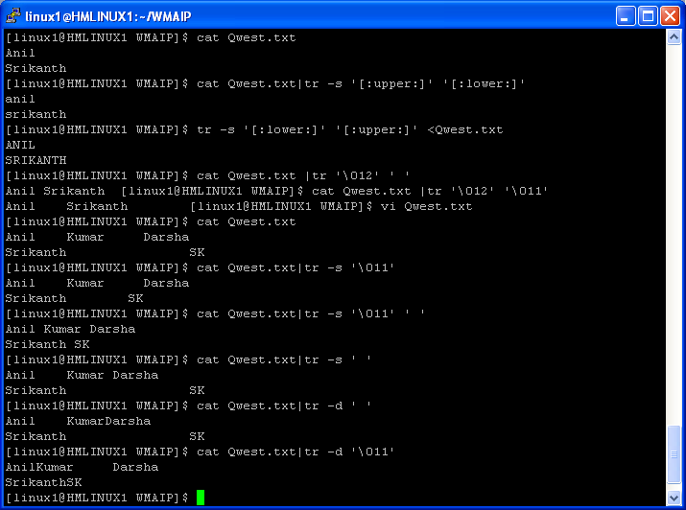
Example : tr

Slide 91
Questions??
1) Let source file(add.txt) is
Name:Anil
City:Bangalore
Phone:12345
Name:Nithin
City:mumbai
Phone:23456
The required output is :
Anil Bangalore 12345
Nithin Mumbai 23456
2) Remove character : from add.txt and save the output to add1.txt
3) Replace character : with | in add.txt and save the output to add3.txt
4) Contents of Testdata is :
<Name>Anil</Name>
<DEPTH>WMAIP</DEPT>
<LOC>BANGALORE</LOC>
<MOB>888-998-9076</MOB>
<Name>SHREY</Name>
<DEPTH>QBAIP</DEPT>
<LOC>NOIDA</LOC>
<MOB>888-998-9075</MOB>
The required output is :
Anil WMAIP BANGALORE 888-998-9076
SHREY QBAIP NOIDA 888-998-9075
Using the same input file ,How to get the following outut ?
Anil BANGALORE 888-998-9076
SHREY NOIDA 888-998-9075

Slide 92
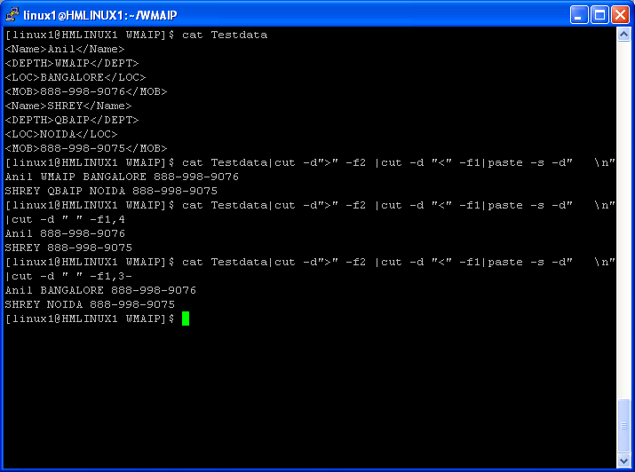
Example :

Slide 93
sort
sort - sort lines of text files
Some useful options of sort command :
-n compare according to string numerical value
-r reverse the result of comparisons
-k --key=POS1[,POS2] ,start a key at POS1, end it at POS 2 (origin 1)
-t --field-separator=SEP use SEP instead of non-blank to blank transition
-u Suppresses all but one line in each set of lines that sort equally according to the sort keys and options.
-o to save the sorted output to a file

Slide 94
Changing the field delimiter
Unless you specify otherwise sort treats the one or more space characters between words as field delimiters. You may want to sort files where words are separated by another character such as a colon (:). Use the -t option to specify another character to act as the field delimiter. For example
-t: specifies the colon (:) character as the delimiter.
One specific delimiter followed by another indicates an empty field. For example with a colon (: ) as a delimiter
field0:field1::field3:field4 field2 is taken to be empty.

Slide 95
Defining the sort field
The first field of each line starts at 0 (zero); the second is 1 (one) and so on. To define which field to sort on you give the position of the field at which to start the sort followed by the position at which to end the sort. The position at which to start the sort is given as the number of fields to skip to get to this position. For example
+2 tells sort to skip the first two fields.
The position at which to stop the sort is given as the number of the field at the end of which the sort stops. For example
-3 tells sort to stop the sort at the end of field three.
To sort on the third field of a line use the definition:
+2 -3 To sort on the fields 5 and 6:
+4 -6

Slide 96
Sorting on a specific part of a field
To define which part of a field to sort on, give the position in the field at which to start the sort followed by the position in the field at which to end the sort.
The position at which to start the sort is given as the number of fields to skip followed by the number of characters to skip. For example:
+2.3 tells sort to skip the first two fields and the first three characters of field 3.
The position at which to stop the sort is given as the number of the field followed by number of the character in that field at which the sort is to stop. For example:
-3.6 tells sort to stop the sort at the 6th character in field three.
To sort on the fourth and fifth characters of field three:
+2.3 -3.6

Slide 97
Saving the results of a sort to a file
sort sends its results directly to your screen. To save them to a file use the -o option. For example:
sort -o sort.out addresses
This saves the results of sorting the file addresses in the file sort.out.
Checking if a file has been sorted
You can check if a file has already been sorted with the -c option. For example:
sort -c +2 -3 accounts
This checks to see if the file accounts has already been sorted on the third field of each line. You will only get a message if the file is not sorted according to this sequence.

Slide 98
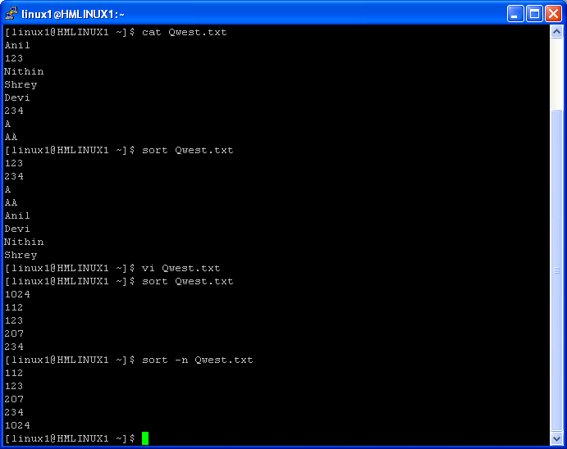
Example : sort

Slide 99
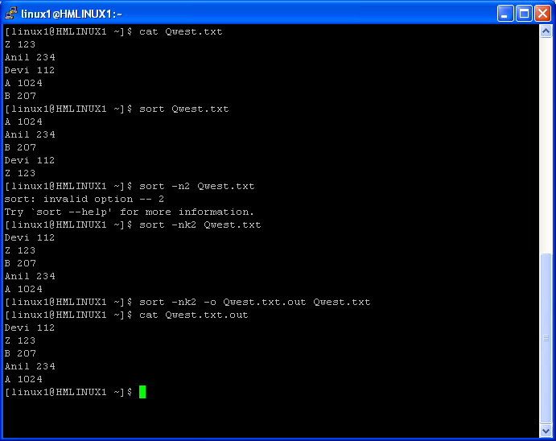
Example: Sort

Slide 100
uniq
uniq - remove duplicate lines from a sorted file
Discard all but one of successive identical lines from INPUT (or standard input), writing to OUTPUT (or standard output).
Some useful options of uniq command :
-c, --count prefix lines by the number of occurrences
-d, --repeated only print duplicate lines
-i, --ignore-case ignore differences in case when comparing
-u, --unique only print unique lines

Slide 101
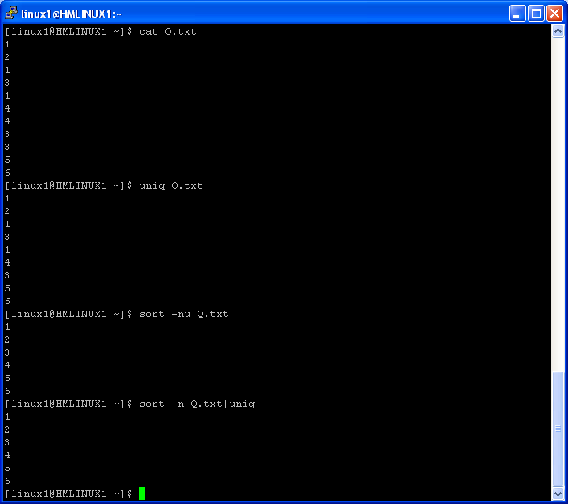
Example : uniq

Slide 102
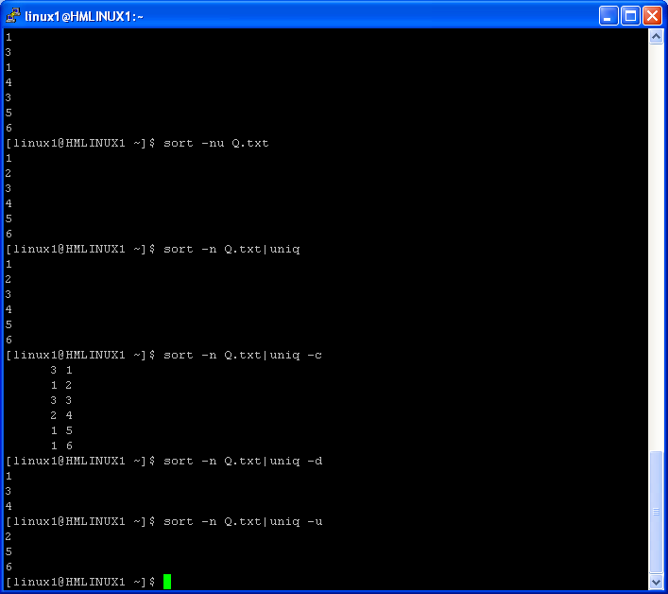
Example : uniq

Slide 103
Questions ??
How to get the list of unique records from a file ?
How to get the list of duplicate records from a file ?
How to get the count of each unique record present in a file ?
Let in a file we have the following contents .How to get the uniq records using sort ?
1
2
1
3
1
4
4
Required output is :
1
2
3
4
What is sort command and explain some useful options of sort command ?
How to perform numeric sort ?
How to get the list of 5 big size files, Which are present in your present working directory ?
Let Qwest.txt file contains 110 lines . Write an one liner which will print the lines 23 to 43 ?
What will be the output of
head Qwest.txt
What will be the output of
tail Qwest.txt
What is tail –f ? When it is required ?
What is the purpose of more command ?
Explain about less and pg ?

Slide 104
comm
comm - compare two sorted files line by line
Syntax : comm [OPTION]... FILE1 FILE2
Compare sorted files FILE1 and FILE2 line by line.
With no options, produce three-column output. Column one contains lines unique to FILE1, column two contains lines unique to FILE2, and column three contains lines common to both files.
-1 suppress lines unique to FILE1
-2 suppress lines unique to FILE2
-3 suppress lines that appear in both files

Slide 105
Questions ???
Contents of Q1.txt is
Anil
Subhasis
Nithin
Contents of Q2.txt is
Anil
Subhasis
Srikanth
How to get the records which are present in Q1.txt but not in Q2.txt ?
How to get the records which are present in Q2.txt but not in Q1.txt ?
How to get the common records present in Q1.txt and Q2.txt ?
Explain comm command ?

Slide 106
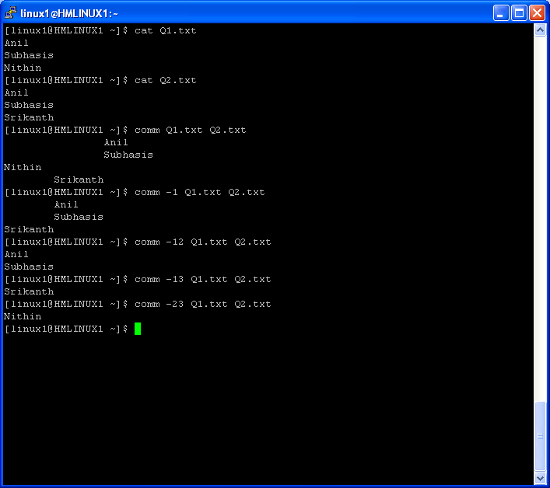
Example : comm

Slide 107
cmp
cmp - compare two files
The cmp utility compares two files of any type and writes the results to the standard output. By default, cmp is silent if the files are the same; If they differ, the byte and line number at which the first difference occurred is reported.
-s Print nothing for differing files; return exit status only.
Exit status of cmp command :
0 The files are identical.
1 The files are different; this includes the case where one file is iden-
tical to the first part of the other. In the latter case, if the -s
option has not been specified, cmp writes to standard output that EOF
was reached in the shorter file (before any differences were found).
>1 An error occurred.

Slide 108
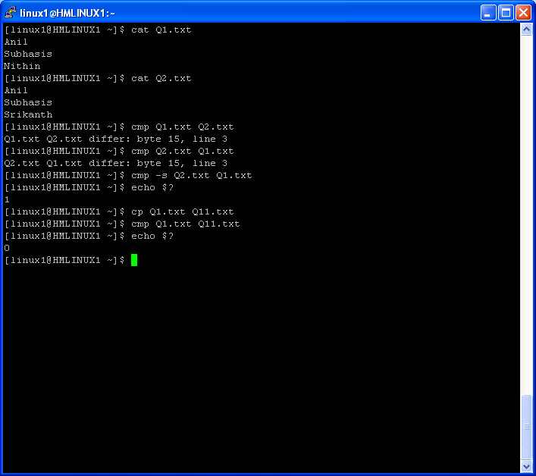
Example : cmp

Slide 109
diff
diff - find differences between two files
-a Treat all files as text and compare them line-by-line, even if they do not seem to be text.
-b Ignore changes in amount of white space.
-B Ignore changes that just insert or delete blank lines.
-i Ignore changes in case; consider upper- and lower-case letters equivalent.
-w Ignore white space when comparing lines.

Slide 110
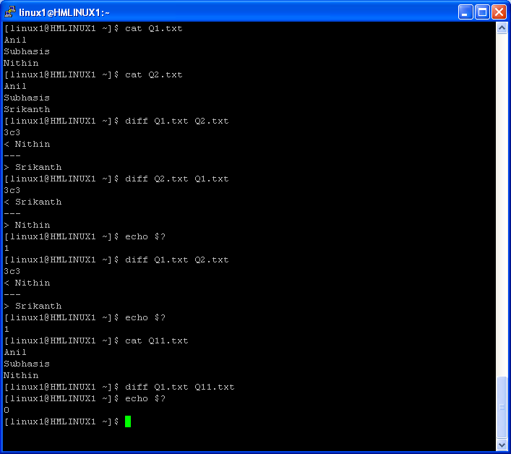
Example : diff

Slide 111
Sdiff,col,seq
sdiff - find differences between two files and merge interactively
col - filter reverse line feeds from input
Col filters out reverse (and half reverse) line feeds so the output is in the correct order with only forward and half forward line feeds, and replaces white-space characters with tabs where possible.
-b Do not output any backspaces, printing only the last character written to each column position.
-f Forward half line feeds are permitted (ââfineââ mode). Normally characters printed on a half line boundary are printed on the following line.
-p Force unknown control sequences to be passed through unchanged. Normally, col will filter out any control sequences from the input other
than those recognized and interpreted by itself, which are listed below.
-x Output multiple spaces instead of tabs.
seq - print a sequence of numbers
-s use STRING to separate numbers (default: \n)
Example :
$ seq -s " " 10
1 2 3 4 5 6 7 8 9 10
If you are using bash shell ( Version 3.0 onwards ) you can use the following command to generate the sequence of numbers .
$ echo {1..10}
1 2 3 4 5 6 7 8 9 10

Slide 112
wc
wc - print the number of newlines, words, and bytes in files
-c print the byte counts
-m print the character counts
-l print the newline counts
-w print the word counts
Example:
$ cat qwest.txt
Qwest Software services
Srikanth
Anil Nithin
Subhasis
$ wc -l qwest.txt
6 qwest.txt
$ cat qwest.txt|wc -l
6
$ cat qwest.txt|wc -c
56
$ cat qwest.txt|wc -m
56
$ cat qwest.txt|wc -w
7

Slide 113
Questions ??
What is cmp command ?
What is the purpose of diff command ?
What is the purpose of sdiff command ?
How to generate the sequence of numbers ?
What is the exit status of cmp command ?
What is the exit status of diff command ?
How to get the exit status of the following command ?
diff Q1.txt Q2.txt
8) How to get the exit status of the following command ?
cmp Q1.txt Q2.txt
9) What is the purpose of col –p ?
10) How to get the following output using seq command ?
1:2:3:4:5:6:7:8:9:10
11)How to get the record/line count of a file ?
12)How to know how many lines are present in a file ?
13)How to know how many words are present in a file ?
14)How to know how many characters are present in a file ?
15)How to know how many alpha numeric characters are present in a file ?

Slide 114
EDITOR
vi
vim

Slide 115
VI EDITOR

Slide 116
Modes of Operation
Ex mode
First session with vi
Environmental variables
Append mode
.exrc & EXINIT variable
Command mode
view

Slide 117
Mode of Operation
Command mode : Default mode when a file is opened using vi. All the keys pressed by the user are interpreted as user commands
Append Mode : Permits insertion of new text, editing existing texts.
Ex mode : Permits commands at the command line(last line of the screen)

Slide 118
Command Mode
R,R,I,I,c,C,o,O,s,S,a,A
Enter
:
Esc
Append Mode
Ex Mode

Slide 119

Vim Tips and Tricks

Slide 120
First Session with vi

Slide 121
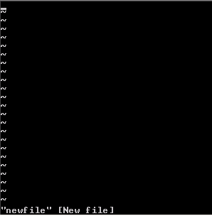
Step 1 : Create a new file by typing the following command from the OS Prompt : vi newfile
vi clears the screen and display a window.
The ‘_’ on the top line indicates that the cursor is waiting for commands
Every other line starts with ‘~’, symbol for empty line.
- Confidential Use Only –
Disclose and distribute only to Qwest employees having a legitimate business need to know. Disclosure outside of Qwest is prohibited without authorization.

Slide 122


Step 2 : Press ‘i’ to enter into Append mode. Add text to the file
Step 3 : Press <Esc> key to return to command mode

Slide 123
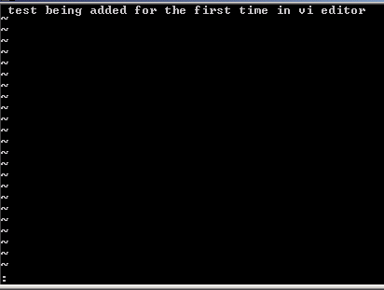
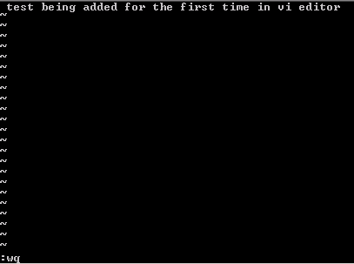

Step 3 : Press ‘:’. The cursor takes to the ‘ex’ mode at the command line. Enter ‘wq’ and press enter.
- Confidential Use Only –
Disclose and distribute only to Qwest employees having a legitimate business need to know. Disclosure outside of Qwest is prohibited without authorization.

Slide 124
Append Mode
Inserting Texts
Cmd | Significance
i | Appends text from the left of the current cursor position
I | Appends text at the start of the current line.
a | Appends text from the right of the current cursor position
A | Appends text at the end of the current line.
o | Opens a line immediately below the current line in input mode
O | Opens a line immediately before the current line in input mode

Slide 125
Changing Texts
Cmd | Significance
<n>r | Replaces <n> characters from current cursor posn. with inserted text
R | Replaces text from cursor to right
<n>s | Replaces <n> characters from cursor with entered text
<n>S | Replaces <n> lines from the current cursor line with entered text
c0 | Changes from cursor to beginning of line with the text entered
c$ | Changes from cursor to end of line with the text entered
C | Change from current cursor posn. to end of line with the text entered
<n>cw | Changes <n> words from the current cursor position with text entered
<n>cc | Replaces <n> lines from the current cursor line with entered text
cG | Changes from current cursor position to end of the file with entered text.

Slide 126
Command Mode
Saving work in a file and quit
Cmd | Significance
ZZ | Saves the work done in the file and quits editing by vi editor
Deleting texts/lines
Cmd | Significance
<n>x | Deletes <n> characters from current cursor position
<n>dd or <n>D | Deletes <n> lines counting from current cursor line to below
d$ | Deletes from current cursor position to end of line
dG | Deletes from current cursot position to end of file
d<n>G | Deletes from current line to line no <n>
df<char> | Deletes from current cursor position to first occurrence of character <char>
d/<pattern> | Deletes from cursor upto the first occurrence of string <pattern> in forward direction
d?<pattern> | Deletes from cursor upto the first occurrence of string <pattern> in backward direction

Slide 127
Moving/Copying Texts
Cmd | Significance
<n>yy or <n>Y | Yank <n> lines starting from current line onwards into undo buffer
<n>yw | Yank <n> words starting from current cursor position onwards into undo buffer
y$ | Yank from current cursor position to end of the line in undo buffer
yG | Yank from current cursor position to end of the file in undo buffer
“a<n>yy | Yank <n> lines starting from current line onwards into buffer named a
p | Paste the contents of undo buffer( as a result of deleting or yanking) after the cursor position
P | Paste the contents of undo buffer( as a result of deleting or yanking) before the cursor position
“ap | Paste the contents of buffer a after the cursor position
“bd | Delete text into named buffer b

Slide 128
Navigation in same line
Cmd | Significance
<n>h | Moves cursor left to nth previous character w.r.t. the current cursor position
<n>l | Moves cursor right to nth next character w.r.t. the current cursor position
<n>b | Moves cursor left to start of nth previous word w.r.t the current cursor position. Punctuation marks are taken into account.
<n>w | Moves cursor right to start of nth next word w.r.t the current cursor position. Punctuation marks are taken into account.
<n>e | Moves cursor right to end of nth next word w.r.t the current cursor position. Punctuation marks are taken into account.
f<ch> | Move the character to the next character <ch> on same line
F<ch> | Move the character to the prv. character <ch> on same line
t<ch> | Move the character to one column before the next character <ch> on same line
T<ch> | Move the character to one column after the next character <ch> on same line
; | Repeats search in the same direction along which the prv. Search was made using f/t

Slide 129





Cmd | Significance
, | Repeats search in the opposite direction along which the prv. Search was made using f/t
<n>| | Moves the cursor to specified column <n>
0 or ( | Moves to 1st character of the current line
$ or ) | Moves to last character of current line
^ | Moves to 1st non-space character of the line
<n>B | Moves cursor left to start of nth previous word w.r.t the current cursor position.Punctuation marks are ignored
<n>W | Moves cursor right to start of nth next word w.r.t the current cursor position. Punctuation marks are ignored
<n>E | Moves cursor right to end of nth next word w.r.t the current cursor position. Punctuation marks are ignored

Slide 130
Navigation across lines
Cmd | Significance
<n>j or <n>^n | Move the cursor down to the <n>th next line in the same column
<n>k or <n>^p | Move the cursor up to the <n>th prv line in the same column
H | Moves the cursor to the top line of the screen
L | Moves the cursor to the last line of the screen
M | Moves the cursor to the middle line of the screen
<n>G | Moves to line number <n>
+ | Moves the cursor to next line’s first non-blank character
- | Moves the cursor to previous line’s first non-blank character

Slide 131
Redraw screen
Cmd | Significance
z- | Makes the current line the last line of the screenand redraws the screen
z+ | Makes the current line the first line of the screenand redraws the screen
z. | Makes the current line the middle line of the screenand redraws the screen
Ctrl-l | Redraws the screen
/pattern/z- | Find the next occurrence of <pattern> and make that last line of the screen

Slide 132
Scrolling across pages
Cmd | Significance
<n>^f | Move forward by <n> screens
<n>^b | Move backward by <n> screens
<n>^d | Move forward by <n> number of half screens
<n>^u | Move backward by <n> number of half screens
<n>^e | Scroll window down by <n> lines
<n>^y | Scroll window up by <n> lines

Slide 133
Pattern searching
Cmd | Significance
/pattern | Searches for specified <pattern> forward. IF end of file is reached, search wraps around.
?pattern | Searches for specified <pattern> backward.
n | Repeat the last search in the same direction as was specified in the last search
N | Repeat the last search in the opposite direction as was specified in the last search
/pattern/+<n> | Positions the cursor <n> number of lines after the line where the specified <pattern> is found
/pattern/-<n> | Positions the cursor <n> number of lines before the line where the specified <pattern> is found
% | Find the matching braces or parenthesis

Slide 134
Joining lines
Cmd | Significance
<n>J | Joins current line and <n> lines below it together to form a single line
Undo changes
Cmd | Significance
u | Undo last change
U | Undo all the changes in the current line
Marking text
Cmd | Significance
m<char> | Marks position of the file with mark <char>
‘<char> | Moves to portion of the file marked with <char>
“ | Toggle to most recently marked location

Slide 135
Restoring previously deleted line
Cmd | Significance
“<n>p | Paste the content of <n>th last delete ( n<=9)
“1pu.u.u… | Till the last change is found
Filtering texts
Cmd | Significance
!<n>G sort | Sort from current line to line no. <n>
!<n>G tr ‘[a-z]’ ‘[A-Z]’ | Translates all the characters from current line to line <n> to uppercase
!! tr ‘[a-z]’ ‘[A-Z]’ | Translates all the characters of current line to uppercase
Repeat factor
Cmd | Significance
<n>i<ch> | Inserts <ch> character <n> number of times in input mode at a stretch

Slide 136
Miscellaneous in command mode
Cmd | Significance
~ | Change the character under cursor from lowercase to uppercase and vice versa
. | Repeat the last change
<n>. | Repeat the last action ‘n’ times
<< | Shift current line to shift width character left
>> | Shift current line to shift width character right

Slide 137
Options available with vi command
Cmd | Significance
vi –r <filename> | Recover the file <filename> as much as possible after system crash and open it
vi –R <filename> | Open the file <filename> in read-only mode
vi +<n> <filename> | Opens the file <filename> with cursor positioned in line number <n>
vi + <filename> | Opens the file <filename> with cursor at the last line
vi –w<n> <filename> | Opens file <filename> in vi mode with window size of <n> number of lines
vi +/<pattern> <filename> | Opens file <filename> in vi editor and places the cursor at first occurrence of pattern <pattern>
vi –x <filename> | Opens encrypted file <filename> in vi mode and asks for the password before opening that

Slide 138
Ex Mode
Saving work in a file
Cmd | Significance
:w | Save the changes made to the file
:w <filename> | Same as “Save As..” in windows. Saves the contents to the specified file <filename> . If it does not exist previously, a new file is created
:w! <filename> | Save the changes to file <filename>, if the file already exists
:w >> <file1> | Append the contents of the opened file after the last line of the file <file1>. File <file1> should exist previously
:<n1>,<n2>w <newfile> | Copies the contents of lines <n1> to <n2> into a new file <newfile>
:<n1>,<n2>w! <newfile> | Moves the contents of lines <n1> to <n2> into an existing file <newfile> , overwriting its previous contents

Slide 139
Cmd | Significance
:.,.+<n>w <newfile> | Appends from current line to <n> number of lines below it into file <newfile>
:.,.+<n>w >> <nextfile> | Appends from current line to <n> number of lines below it after the last line of the file <nextfile>
:q | Quits the file editing in vi, provided no unsaved change remains
:q! | Quits vi neglecting all the unsaved changes made to the file
:wq or :x | Save the unsaved changes in the opened file and quit vi editor
Temporary exit to shell
Cmd | Significance
:sh | Temporarily allows the user to come out of the vi file and use the shell. After the job of the user is done and command : exit is triggered from OS prompt, control returns to vi editor again

Slide 140

Navigating to desired line
Cmd | Significance
:<n> | Custor moves to line number <n>
Search and replace texts in ex mode
Syntax :- :<line address>s/<old pattern>/<new pattern>/g
Line address | Significance
% | All lines where matching pattern is found
. | Current line
<n1>,<n2> | Refers from line <n1> to <n2>
$ | Last line
1,$ | First to last line
.,.+<n> | From current cursor line to <n> number of lines downwards

Slide 141
Examples of Search and Replace
Example | Significance
:%s/ex/vi/c | Substitutes 1st occurrence of string ‘ex’ with ‘vi’ by showing them and asking for confirmation. When each string will be shown with pause in cursor, press ‘y’ for substitution
:%s /<amaze \ >\/delight/g | Replaces ‘amaze’ , where available as a full word, with ‘delight’. Note, any word like ‘amazed’ will not be replaced
:g/subhendu/s/majumdar/mazumder/g | Replaces every occurrence of string ‘majumdar’ with ‘mazumder’ on all lines containing the pattern ‘subhendu’
:g/.\ {9\ }9/s/0/*/g | Replaces ‘0’ with ‘*’ at all lines having ‘9’ after 9th position
:g/^$/d | Delete all blank lines
:g!/complete/s/$/To be done/ | Append the string ‘To be done’ at the end of all lines not containing the string ‘complete’

Slide 142
Example | Significance
:g/vi/s/^/editor/ | Append the string ‘editor’ at the first of all lines containing the string ‘vi’
:%s/$/ : see my note/g | Appends the string ‘: see my note’ at the end of all lines
:g/^….$/d | Deletes all lines containing 4 letters
:g/^..o/d | Deletes all lines with ‘o’ as 3rd character
:%s/…$//g | Delete the last three character of every line
Reading below the current line in the vi editor
Command | Significance
:r <nextfile> | Reads the contents of the file <nextfile> below current line
:r! <command> | Places the output of the command <command> below the current line
- Confidential Use Only –
Disclose and distribute only to Qwest employees having a legitimate business need to know. Disclosure outside of Qwest is prohibited without authorization.

Slide 143
Editing another file
Command | Significance
:e <nextfile> | Stops editing the current file; leaves the current file and starts editing file <nextfile>; provided there are no unsaved changes in the current file
:e! <nextfile> | Edits file <nextfile> abandoning all the changes done to the current file
:e! | Loads last saved version of current file
:n | Edits next file mentioned in the vi queue
:rew | Edits first file in the command line
:e +<n> <nextfile> | Edit starts at line <n> of file <nextfile>
- Confidential Use Only –
Disclose and distribute only to Qwest employees having a legitimate business need to know. Disclosure outside of Qwest is prohibited without authorization.

Slide 144
Abbreviating texts
Command | Significance
:ab <short_string> <long_string> | When the user writes the string <short_string> in input mode, the <long_string> is written
Mapping
Command | Significance
:map g :w^M | Pressing ‘g’, one wants to save the file(:w is for saving, and ^M is for pressing Enter key. While writing it in the command line, write ^V^M)
:map z i^M^[ | When you position your cursor to any character in a line and press ‘z’ , the line will be broken from that point and two lines will be formed. The control will remain in command mode (^[ represents <Escape> key)
:map z :w^M:!%^M | Pressing ‘z’ in command mode saves the file and executes it in one shot
To unmap a key, write at the command line :unmap <key>

Slide 145
Miscellaneous
Command | Significance
:! <command> | Executes the command <command> remaining in vi editor
:f | Shows the name of the current file and line
^g | Same as :f

Slide 146
Setting environmental variables for vi
Works in ex mode.
To set an environment variable to customize vi, the following syntax needs to be followed:-
:set <env.variable> [= <value>]

Slide 147
Environment variables | Significance
autoindent(ai) | Newly inserted lines of text are indented to the same distance from left margin as the preceding line. Opposite of this option is noautoindent(noai)
autowrite(aw) | Automatically saves the unsaved changes in a file before opening the next file with :n or using a shell command with :! <command>. The opposite to this option is noautowrite(noaw)
errorbells(eb) | Sounds the bell when error occurs. Opposite is ‘noeb’
exrc(ex) | Allows an .exrc file in the current directory to override the .exrc file in user’s home directory. Opposite is ‘noex’
list | Displays special characters in the screen: tabs are shown as ^I, end of line are marked with ‘$’. Opposite is ‘nolist’
mesg | System messages allowed when vi is running. Opposite is ‘nomesg’
number( nu ) | Displays line numbers. Opposite is ‘nonu’

Slide 148
Environment variables | Significance
report=<val> | When any operation affects more lines than this settings, message is displayed
scroll=<val> | Number of screen lines to scroll
shiftwidth(sw)=<val> | Number of spaces to be used for backtabs/<</>>
showmatch(sm) | Shows match for ) or } . Opposite is ‘nosm’
showmode | Indicates type of mode
tabstop=<val> | No. of spaces the tab character moves over
ignorecase(ic) | Ignores case when searches patterns. Opposite is ‘noic’
wrapmargin(wrm)=<val> | When set to a value >0 , carriage returns are inserted automatically when the cursor gets to within that number of spaces from the right edge of the screen

Slide 149
One can store all the values for environment variables, all the key mappings and all the abbreviations in a file ‘.exrc’ under the home directory for the user.VI looks for this file on startup and executes the instructions as ex mode commands.
Besides, there is also a system variable , ‘EXINIT’ which can also be used to save the settings.
EXINIT=“set report=5 ignorecase ai”; export EXINIT

Slide 150
view
Syntax : view <filename>
Description :Shows the file <filename> in vi mode. File remains read-only. No changes done to the file cannot be saved.

Slide 151
Questions ??
How to view a file ?
Suppose you opened a file with view command and did some modification .How to save the modifications ?
How to save a file ?
Suppose 2 users opened the same file .one of the user modified some contents .The other user wants to see the content without exiting from the vi editor .What is the command to refresh/ see the modified contents of the file ?
How to insert a text to a file ?
What is the command to come back to the shell temporarily ?
What is the command to save and exit from vi editor ?
What is the command to exit without save ?
What is wq! ?
What is q! ?
How to go to the last line of a file ?
How to go the end of the current line ?
How to add a line below and above the current cursor position ?
How to go to a specific line ? Let line 10 ?
How to append text to the end of a line and in between ?
How to join two lines ?
How to set the line numbers ?
How to unset the line number ?
How to move up ,down ,left and right from the cursor position ?
How to delete a word ?

Slide 152
Questions ??
How to delete 3 words from current cursor position ?
How to delete 3 characters from current cursor position ?
How to replace a character ?
How to delete a single line ?
How to delete multiple lines ?
How to undo ?
How to copy line # 15 to # 20 after line number 36 ?
How to move line # 15 to # 20 after line number 36 ?
How to copy 5 lines from the current position and paste it as per requirement ?
What is w ?
How many modes are present in vi ?
Suppose in a file Qwest pattern is present . How will you replace Qwest with IBM ?
Suppose in a file Qwest pattern is present . How will you replace Qwest with IBM from line number 3 to 9?
What is . And $ ?
Suppose in a file Qwest pattern is present . How will you replace Qwest with IBM from line number 1 to current cursor position?
Suppose in a file Qwest pattern is present . How will you replace Qwest with IBM from line number current cursor position to last line?
How to edit multiple files ?What is ‘n’ and ‘rew’ ?
Suppose I want edit the line 10 of a file .When the file will be opened ,I want the cursor should be present in the very beginning of line # 10 ?
How to copy the contents from a file and paste the same copied content in the current file .

Slide 153
Pattern searching
- grep
- egrep
- fgrep

Slide 154
grep, egrep, fgrep
grep, egrep, fgrep - print lines matching a pattern.
Grep searches the named input FILEs (or standard input if no files are named, or the file name - is given) for lines containing a match to the given PATTERN. By default, grep prints the matching lines.
In addition, two variant programs egrep and fgrep are available. Egrep is the same as grep -E. Fgrep is the same as grep -F.
-c Prints only a count of the lines that contain the pattern.
-e pattern_list
Specifies one or more patterns to be used ring the search for input. Patterns in pattern_list must be separated by a NEWLINE character.
-F Interpret PATTERN as a list of fixed strings, separated by newlines, any of which is to be matched.
-h Suppress the prefixing of filenames on output when multiple files are searched.
-i Ignore case distinctions in both the PATTERN and the input files.

Slide 155
Useful options of grep:
-L --files-without-match , Suppress normal output; instead print the name of each input file from which no output would normally have been printed. The scanning will stop on the first match.
-l --files-with-matches Suppress normal output; instead print the name of each input file from which output would normally have been printed. The scanning will stop on the first match.
-n --line-number,Prefix each line of output with the line number within its input file.
-o --only-matching,Show only the part of a matching line that matches PATTERN.
-R, -r --recursive,Read all files under each directory, recursively; this is equivalent to the -d recurse option.
-s Suppresses error messages about nonexistent or unreadable files.
-w Select only those lines containing matches that form whole words.
The test is that the matching substring must either be at the beginning of the line, or preceded by a non-word constituent character.
Similarly, it must be either at the end of the line or followed by a non-word constituent character. Word-constituent characters are letters, digits, and the underscore.

Slide 156
REGULAR EXPRESSION
^ (Caret) | match expression at the start of a line, as in ^A.
$(Dollar) | match expression at the end of a line, as in A$.
\ (BackSlash) | turn off the special meaning of the next character, as in \^.
[ ] (Brackets) | match any one of the enclosed characters, as in [aeiou]. Use Hyphen "-" for a range, as in [0-9].
[^ ] | match any one character except those enclosed in [ ], as in [^0-9].
. (Period) | match a single character of any value, except end of line.
* (Asterisk) | match zero or more of the preceding character or expression.
\{x,y\} | match x to y occurrences of the preceding.
\{x\} | match exactly x occurrences of the preceding.
\{x,\} | match x or more occurrences of the preceding.

Slide 157
Example
grep Qwest files | {search files for lines with 'Qwest'}
grep '^Qwest' files | {'Qwest' at the start of a line}
grep 'Qwest$' files | {'Qwest' at the end of a line}
grep '^Qwest$' files | {lines containing only 'Qwest'}
grep '\^s' files | {lines starting with '^s', "\" escapes the ^}
grep '[Qq]west' files | {search for 'Qwest' or ‘qwest'}
grep 'B[oO][bB]' files | {search for BOB, Bob, BOb or BoB }
grep '^$' files | {search for blank lines}
grep '[0-9][0-9]' file | {search for pairs of numeric digits}

Slide 158
Example
grep '^From: ' /usr/mail/$USER | {list your mail}
grep '[a-zA-Z]' | {any line with at least one letter}
grep '[^a-zA-Z0-9] | {anything not a letter or number}
grep '[0-9]\{3\}-[0-9]\{4\}' | {999-9999, like phone numbers}
grep '^.$' | {lines with exactly one character}
grep '“Qwest"' | {‘Qwest' within double quotes}
grep '"*Qwest"*' | {'Qwest', with or without quotes}
grep '^\.' | {any line that starts with a Period "."}
grep '^\.[a-z][a-z]' | {line start with "." and 2 lower case letters}

Slide 159
Example:
1)Search /etc/passwd for linux1 user:
$ grep linux1 /etc/passwd
2)You can force grep to ignore word case i.e match linux1, Linux1, LINUX1 and all other combination with -i option:
$ grep -i "linux1" /etc/passwd
3)Use grep recursively
You can search recursively i.e. read all files under each directory for a string "10.140.7.1"
$ grep -r "10.140.7.1" /etc/
4)Use grep to search words only
When you search for linux1, grep will match TRNlinux1, Linux123, etc.
You can force grep to select only those lines containing matches that form whole words i.e. match only linux1 word:
$ grep -w "linux1" /path/of/file
5) Use grep to search 2 different words
use egrep as follows:
$ egrep -w 'word1|word2' /path/of/file

Slide 160
Example:
6)Count lines when words has been matched
grep can report the number of times that the pattern has been matched for each file using -c (count) option:
$ grep -c 'word' /path/to/file
7) you can use -n option, which causes grep to precede each line of output with the number of the line in the text file from which it was obtained:
$ grep -n 'word' /path/to/file
8)Grep invert match
You can use -v option to print inverts the match; that is, it matches only those lines that do not contain the given word. For example print all line that do not contain the word Qwest:
$ grep -v Qwest /path/to/file
9) grep command often used with pipes. For example print name of hard disk devices:
# dmesg | egrep '(s|h)d[a-z]'
10)Display cpu model name:
# cat /proc/cpuinfo | grep -i 'Model'
However, above command can be also used as follows without shell pipe:
# grep -i 'Model' /proc/cpuinfo
11)Use the -l option to list file name whose contents mention main():
$ grep -l 'main' *.c
12)you can force grep to display output in colors:
$ grep --color linux1 /etc/passwd

Slide 161
Questions ??
1)How to get the password file entry for linux1 user?
2)Let the user name is unknown .It may be linux1, Linux1, LINUX1 .In that scenarion how to get the password file entry for linux1 user ?
3)How to search recursively /etc/ directory ,To get the list of files containing string "10.140.7.1" ?
4)When you search for linux1, grep will match TRNlinux1, Linux123, etc.How to force grep to select only those lines containing matches that form whole words i.e. match only linux1 word: ?
5) How to use grep to search 2 different words in a file Qwest.txt .The words are : Anil and srikanth ?
6)How to count lines when words has been matched ?
7) What is the use of -n option ( grep -n) ?
8)How to print the line that does not contain Qwest string ?
9)How to get the name of files which conains the string "Nithin" ?
10) grep command often used with pipes. For example print name of hard disk devices:
# dmesg | egrep '(s|h)d[a-z]'
11)Display cpu model name:
# cat /proc/cpuinfo | grep -i 'Model'
However, above command can be also used as follows without shell pipe:
# grep -i 'Model' /proc/cpuinfo
12)you can force grep to display output in colors:
$ grep --color linux1 /etc/passwd

Slide 162
Searching and Archiving
Searching files :
find
Archiving commands
- tar
- zip
- unzip
- gzip
- gunzip
- compress
- uncompress
- zcat and gzcat

Slide 163
find
find - search for files in a directory hierarchy
-type <c>
File is of type c:
b block (buffered) special
c character (unbuffered) special
d directory
p named pipe (FIFO)
f regular file
l symbolic link
s socket
-perm mode File's permission bits are exactly mode (octal or symbolic).
Symbolic modes use mode 0 as a point of departure.
-perm -mode All of the permission bits mode are set for the file.
-perm +mode Any of the permission bits mode are set for the file.

Slide 164
find
-newer file
File was modified more recently than file. -newer is affected by -follow only if -follow comes before -newer on the command
-name pattern
Base of file name (the path with the leading directories removed) matches shell pattern pattern. The metacharacters (`*', `?', and `[]') do not match a `.' at the start of the base name. To ignore a directory and the files under it, use -prune; see an example in the description of -path.

Slide 165
find
+n for greater than n,
-n for less than n,
n for exactly n.
-amin n File was last accessed n minutes ago.
-atime n File was last accessed n*24 hours ago.
-mmin n Fileâs data was last modified n minutes ago.
-mtime n Fileâs data was last modified n*24 hours ago.
-size n[cwbk] File uses n units of space. The following suffixes can be used:
b for 512-byte blocks (this is the default if no suffix isused)
c for bytes
w for two-byte words
k for Kilobytes (units of 1024 bytes)

Slide 166
find
-user uname File is owned by user uname (numeric user ID allowed).
-uid n File's numeric user ID is n.
-links n File has n links.
-inum n File has inode number n.
-gid n Files numeric group ID is n.
-group gname File belongs to group gname (numeric group ID allowed).
-maxdepth levels
Descend at most levels (a non-negative integer) levels of directo-
ries below the command line arguments. -maxdepth 0 means only
apply the tests and actions to the command line arguments.

Slide 167
Example:find
1) Search the file Qwest.txt from current directory downwards and print it ?
find . -name "Qwest.txt" -print
2) Find all files which begin with 'S' or 'N' from current directory downwards and print them ?
find . -name “[SN]*” -print
3)Search directories called backup from /opt/proj directory downwards and print them ?
find /opt/proj -type d -name backup -print
4)Search normal files called test.log /opt/proj directory downwards and print them ?
find /opt/proj -type f -name test.log -print
5) Search character special files called test.log /opt/proj directory downwards and print them ?
find /opt/proj -type c -name test.log -print

Slide 168
Example:find
6) Search block special files called test.log /opt/proj directory downwards and print them ?
find /opt/proj -type b -name test.log -print
7) Search all directories from /opt/proj directory downwards for files whose inode number is 3456 ?
find /opt/proj -inum 3456 -print
8) Search root directory downwards for files which have exact link count 2 ?
find / -links 2 -print
9) Search root directory downwards for files which have less than 2 links ?
find / -links -2 -print
10) Search root directory downwards for files which have more than 2 links ?
find / -links +2 -print

Slide 169
Example:find
11) Search current directory downwards for all files whose owner is Qwest and group is default ?
find . \( -user Qwest -a -group default \) -print
12)Search current directory downwards for all files whose owner is Qwest or name is Qwest.txt ?
find . \( -user Qwest -o -name Qwest.txt \) -print
13)Search in current directory downwards for all files which have permissions 777?
find . -perm 777 -print
14)Search in current directory downwards for all files whose size is 10 blocks?
find . -size 10 -print
15)Search in current directory downwards for all files whose size is 10 bytes (characters)?
find . -size 10c -print
16)Search in current directory downwards for all files whose size is greater than 10 bytes?
find . -size +10c -print

Slide 170
Example:find
17)Search in current directory downwards for all files whose size is less than 10 bytes?
find . -size -10c -print
18)Search in current directory downwards for all files which were accessed exactly 7 days back ?
find ./ -atime 7 -print
19)Search in current directory downwards for all files which were accessed more than 7 days ago ?
find ./ -atime +7 -print
20)Search in current directory downwards for all files which were modified more than 7 days ago ?
find . -mtime +7 -print

Slide 171
Example:find
21)Search in current directory downwards for all files whose name is core and remove the files ?
find . -name "core" -type f -exec rm {} \;
{} -- > Means files returned by find command would become arguments for rm.
find . -name "core" -type f -print | xargs rm
find . -name "core" -type f -print | xargs -t rm
find . -name "core" -type f -print | xargs -t rm -f
22)Search in current directory downwards for all files whose name is core and remove the files ? If confirmation is required before removing the files use -ok
find . -name "core" -type f -ok rm {} \;

Slide 172
Example:find
23) Search in current directory downwards for all files which are modified after /tmp/Qwest.txt ( newer than /tmp/Qwest.txt) ?
find . –newer /tmp/Qwest.txt -print
24) Search only in current directory ( not in sub directories ) for all files which are modified after /tmp/Qwest.txt ( newer than /tmp/Qwest.txt) ?
find . –maxdepth 1 –newer /tmp/Qwest.txt -print
find . ! –name . –prune –newer /tmp/Qwest.txt -print

Slide 173
Find : -prune Example
$ find . -type f -print
./C/c.txt
./F/F.txt
./E/E.txt
./A/a.xtx
./D/d.txt
./B/b.txt
./ttt.txt
$ find . -path ./B -prune -o -path ./C -prune -o -type f -print
./F/F.txt
./E/E.txt
./A/a.xtx
./D/d.txt
./ttt.txt
$ find . -path ./B -prune -o -path ./C -prune -o -path ./D -prune -o -type f -print
./F/F.txt
./E/E.txt
./A/a.xtx
./ttt.txt

Slide 174
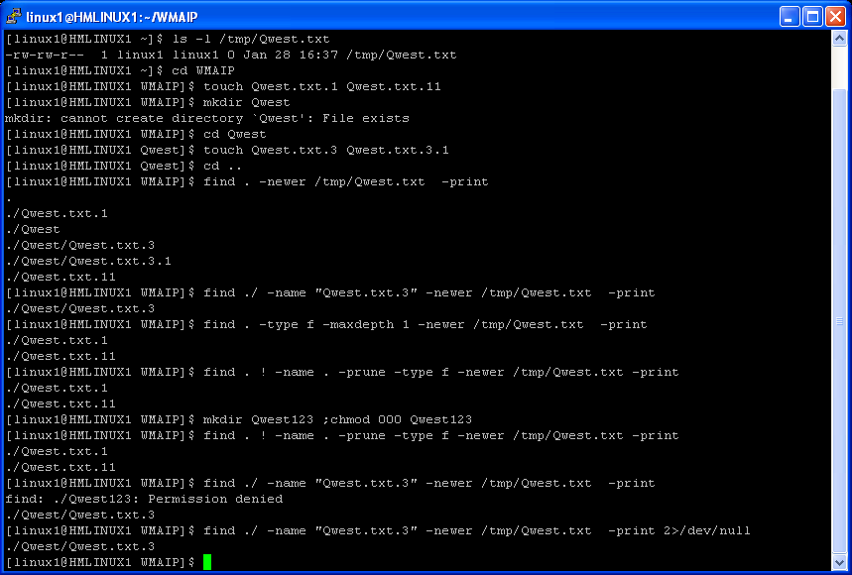
Example : find ( -newer , – maxdepth , -prune )

Slide 175
Questions ??
1) How to search the file Qwest.txt from current directory downwards?
2) How to find all files which begin with 'S' or 'N' from current directory downwards ?
3) How to search directories called backup from /opt/proj directory downwards ?
4) How to search all directories from /opt/proj directory downwards for files whose inode number is 1234 ?
5) How to search root directory downwards for files which have less than 2 links ?
6) How to search current directory downwards for all files whose owner is Qwest and group is default ?
7) How to search in current directory downwards for all files whose size is greater than 3mb?
8) How to search in current directory downwards for all files which were accessed more than 2 months ago ?
9) How to search in current directory downwards for all files which were modified more than 1 year ago ?
10)How to search in current directory downwards for all files which were modified in last 10 hours ?
11)How to search in current directory downwards for all files which were modified more than 5 hours ago ?
12)Search in current directory downwards for all files whose name is core and remove the files ?
13) What is the difference between xargs and exec ?
14)Search in current directory downwards for all files which are modified after /tmp/Qwest.txt ( newer than /tmp/Qwest.txt) ?
15)Search only in current directory ( not in sub directories ) for all files which are modified after /tmp/Qwest.txt ( newer than /tmp/Qwest.txt) ?
16)What is the equivalent option for -maxdepth 1 ?
17)Which one of the following command is better and safe ?
find ./ -name "Qwest.txt" -type f -ls
find ./ -name "Qwest.txt" -type f -print |xargs ls -l

Slide 176
tar
tar - create tape archives and add or extract files
tar –cvf Create an archive
tar –tvf To See the contents of exhisting archive
tar rf To add a file to the exhisting archive
tar --delete --file= To delete a file from the archive
tar –xvf To Extract file/specific file from the archive
tar --remove Remove the source once archived
Create an archive: ( tar –cvf )
$ ls -C1
1.txt
Alignment.ksh
Alignment_printf.ksh
mytest
test.data
$ tar -cvf test.tar ./*
./1.txt
./Alignment.ksh
./Alignment_printf.ksh
./mytest
./test.data

Slide 177
tar
To See the contents of exhisting archive : ( tar –tvf )
$ tar -tvf test.tar
-rw-rw-r-- linux1/linux1 68 2008-09-05 13:52:48 ./1.txt
-rwxrwxr-x linux1/linux1 949 2008-09-08 18:46:20 ./Alignment.ksh
-rwxrwxr-x linux1/linux1 867 2008-09-05 14:36:04 ./Alignment_printf.ksh
-rw-rw-r-- linux1/linux1 5 2008-09-10 16:33:53 ./mytest
-rw-rw-r-- linux1/linux1 240 2008-09-05 14:42:57 ./test.data
To delete a file from the archive (tar --delete --file= )
$ tar --delete --file=test.tar ./mytest
$ tar -tvf test.tar
-rw-rw-r-- linux1/linux1 68 2008-09-05 13:52:48 ./1.txt
-rwxrwxr-x linux1/linux1 949 2008-09-08 18:46:20 ./Alignment.ksh
-rwxrwxr-x linux1/linux1 867 2008-09-05 14:36:04 ./Alignment_printf.ksh
-rw-rw-r-- linux1/linux1 240 2008-09-05 14:42:57 ./test.data
To add a file to the exhisting archive (tar rf )
$ tar rf test.tar ./mytest
$ tar -tvf test.tar
-rw-rw-r-- linux1/linux1 68 2008-09-05 13:52:48 ./1.txt
-rwxrwxr-x linux1/linux1 949 2008-09-08 18:46:20 ./Alignment.ksh
-rwxrwxr-x linux1/linux1 867 2008-09-05 14:36:04 ./Alignment_printf.ksh
-rw-rw-r-- linux1/linux1 240 2008-09-05 14:42:57 ./test.data
-rw-rw-r-- linux1/linux1 5 2008-09-10 16:33:53 ./mytest

Slide 178
tar,cpio
To Extract file from the archive ( tar –xvf )
$ tar -xvf test.tar
./1.txt
./Alignment.ksh
./Alignment_printf.ksh
./test.data
./mytest
Extracting a specific file from the archive ( tar –xvf )
$ tar -xvf test.tar ./test.data
./test.data
Remove the source once archived (tar --remove )
$tar --remove -cvf target.tar ./Source/*
cpio - copy files to and from archives

Slide 179
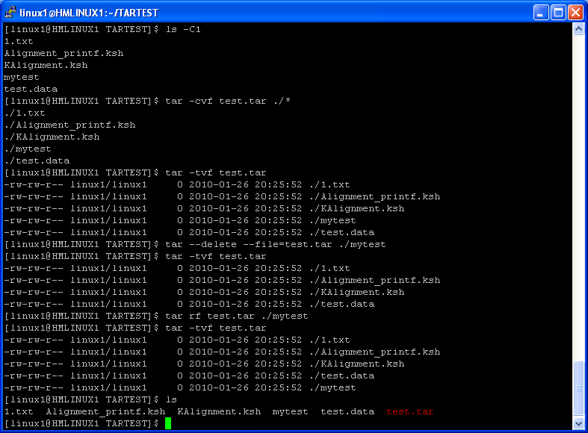
Example :

Slide 180
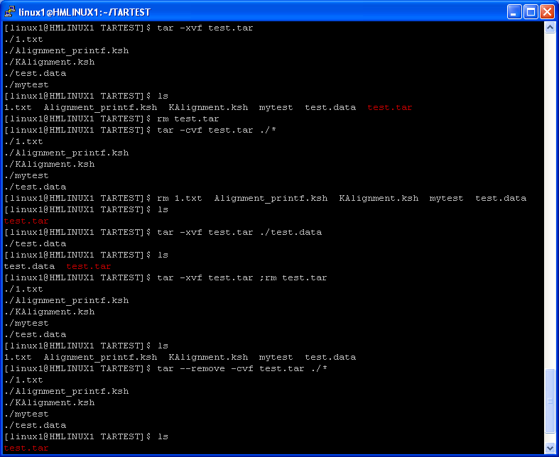
Example :

Slide 181
zip and unzip
zip is a compression and file packaging utility
When given the name of an existing zip archive, zip will replace identically named entries in the zip archive or add entries for new names. For example, if foo.zip exists and contains foo/file1 and foo/file2, and the directory foo contains the files foo/file1 and foo/file3, then:
zip -r foo foo
will replace foo/file1 in foo.zip and add foo/file3 to foo.zip. After this, foo.zip contains foo/file1, foo/file2 and foo/file3, with foo/file2 unchanged from before.
Another example :
find . -name "*.[ch]" -print | zip source -@
zip also accepts a single dash ("-") as the name of a file to be compressed, in which case it will read the file from standard input, allowing zip to take input from another program. For example:
tar cf - . | zip backup –
-b path Use the specified path for the temporary zip archive. For example:
zip -b /tmp stuff *
-d Remove (delete) entries from a zip archive. For example:
zip -d foo foo/tom/junk foo/harry/\* \*.o

Slide 182
zip and unzip
To extract all members of Qwest.zip into the current directory only:
unzip Qwest.zip
To test Qwest.zip, printing only a summary message indicating whether the archive is OK or not:
unzip -j Qwest
To extract all FORTRAN and C source files--*.f, *.c, *.h, and Makefile--into the /tmp directory:
unzip Qwest.zip "*.[fch]" Makefile -d /tmp

Slide 183
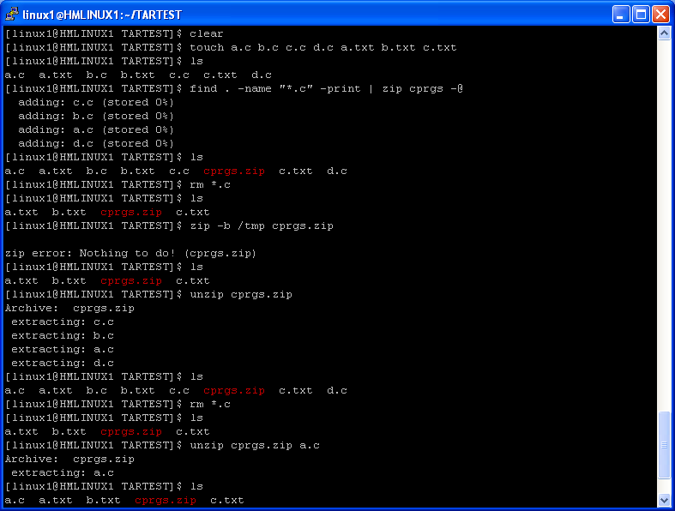
Example:

Slide 184
gzip and gunzip
gzip – To compress the file
Compressed files can be restored to their original form using gzip -d or gunzip or zcat.
-r --recursive operate recursively on directories
-1 --fast compress faster
-9 --best compress better
-h --help help
-d decompress
-f --force force overwrite of output file and compress links

Slide 185
gzip and gunzip
gunzip – To uncompress the file
Compressed files can be restored to their original form using gunzip.
-r --recursive operate recursively on directories
-1 --fast uncompress faster
-9 --best uncompress better
-h --help help
-d decompress

Slide 186
compress / uncompress ,gzcat ,zcat
compress, uncompress, zcat - compress and expand data
compress -v Qwest.exe - Would compress Qwest.exe and rename that file to Qwest.exe.Z
uncompress Qwest.txt.z - would uncompress the file Qwest.txt.Z
zcat Qwest.txt.z - To view the contents of Qwest.txt.z file
gzip Qwest.txt - To compress the file using gzip
gzcat Qwest.txt.gz - To view the contets of Qwest.txt.gz
gunzip Qwest.txt.gz -To uncompress the file Qwest.txt.gz
NB : zcat and gzcat both are same .Most of the recent OS contains zcat only .

Slide 187
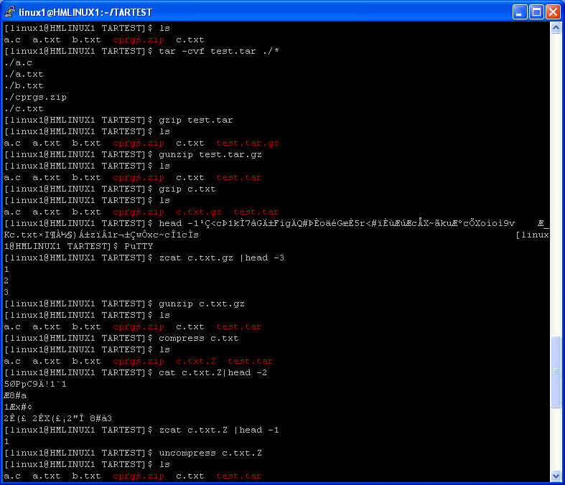
Example:

Slide 188
Questions ??
How to create a tar archive ?
How to extract a tar archive ?
How to see the contents of a tar archive ?
How to add a new file to a existing tar archive ?
How to remove a file from a existing tar archive ?
How to tar and gzip at the same time ?
How to gzip a file ?
How to gzip all files present in a directory ?
How to unzip a .gz file ?
How to zip a directory ?
How to unzip zip archive ?
How to view the contents of .gz file ?
How to compress a file and and how to view the contetnts of a compressed file ?
How to uncompress a compressed file ?

Slide 189
Process management
- ps
- kill
- nice
- jobs
- fg
- bg
- nohup
- vmstat
- iostat
- top
- sar
- pgrep
- pkill
- pwdx
- time

Slide 190
ps
ps - report a snapshot of the current processes.
-A Select all processes. Identical to -e.
-a Select all processes except session leaders and processes not associated with a terminal.
-e Select all processes. Identical to -A.
-p Select by PID.This selects the processes whose process ID numbers appear in pidlist. Identical to p and --pid.
-u Select by effective user ID (EUID) or name.
-f does full-format listing.
-l long format
-w Wide output. Use this option twice for unlimited width.
-L Show threads, possibly with LWP and NLWP columns
-T Show threads, possibly with SPID column
-m Show threads after processes

Slide 191
PROCESS STATE CODES
Here are the different values that the s, stat and state output specifiers (header "STAT" or "S") will display to describe the state of a process.
D Uninterruptible sleep (usually IO)
R Running or runnable (on run queue)
S Interruptible sleep (waiting for an event to complete)
T Stopped, either by a job control signal or because it is being traced.
W paging (not valid since the 2.6.xx kernel)
X dead (should never be seen)
Z Defunct ("zombie") process, terminated but not reaped by its parent.

Slide 192
Description : ( Some of the useful fields )
S The state of the process or kernel thread.
UID Owner/user of the process
PID The process ID of the process.
PPID The process ID of the parent process.
PRI The priority of the process or kernel thread; higher numbers mean lower priority
STIME The starting time of the process.
TIME The total execution time for the process.
SZ The size in 1KB units of the core image of the process.
TTY The controlling workstation for the process:
- The process is not associated with a workstation.
? Unknown.
WCHAN The event for which the process or kernel thread is waiting or sleeping.
NI Nice value
ADDR Contains the segment number of the process stack, if normal; if a kernel process, the address of the preprocess data area.
CMD Contains the command name

Slide 193
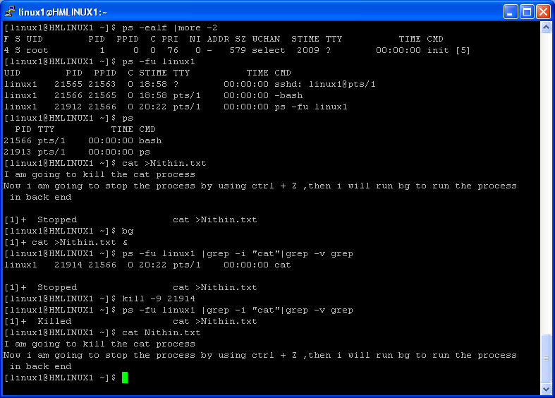
Example:

Slide 194
kill
kill - terminate a process
-l Print a list of signal names.
1. To stop a given process, enter:
kill 1095
This stops process 1095 by sending it the default SIGTERM signal.
Note that process 1095 might not actually stop if it has made special arrangements to ignore or override the SIGTERM signal.
2. To stop several processes that ignore the default signal, enter:
kill -kill 2098 1569
This sends signal 9, the SIGKILL signal, to processes 2098 and 1569.
The SIGKILL signal is a special signal that normally cannot be ignored or overridden.
3. To stop all of your processes and log yourself off, enter:
kill -kill 0
This sends signal 9, the SIGKILL signal, to all processes having a process group ID equal to the senders process group ID. Because the shell cannot ignore the SIGKILL signal, this also stops the login shell and logs you off.

Slide 195
kill
4. To stop all processes that you own, enter:
kill -9 -1
This sends signal 9, the SIGKILL signal, to all processes owned by the effective user, even those started at other work stations and that belong to other process groups. If a listing that you requested is being printed, it is also stopped.
5. To send a different signal code to a process, enter:
kill -USR1 1103
The name of the kill command is misleading because many signals, including SIGUSR1, do not stop processes. The action taken on SIGUSR1 is defined by the particular application you are running.
6. To force kill a process use:
kill -9 PID
Note: To send signal 15, the SIGTERM signal with this form of the kill command, you must explicitly specify -15 or TERM.

Slide 196
Questions ??
How to list all process of the user Qwest ?
2)How to list all processes ?
3) Which one is the 1st process ?
4)How to get the current state of the process ?
5)How to identify a zombie process ?
6)How to get the startup time of the process ?
7)How to get the nice value of the process ?
8)How to get the priority of a process ?
9)How to get the current kernel operation of a process ?
10)How to get the pid and ppid of a process ?
11) How to get the owner details of a process ?
12)How to stop a given process ?
13)How to kill a process forcefully ?
14)How to terminate a process ?
15) How to stop several processes that ignore the default signal ?
16) Which command will stop all of your processes and log yourself off ?
17)How to stop all processes that you own ?
18)How to get the list of signals ?
19) How to kill the last back ground job ?
20)How to get the PID of current shell ?

Slide 197
nice
nice - run a program with modified scheduling priority
Usage: nice [OPTION] [COMMAND [ARG]...]
Run COMMAND with an adjusted scheduling priority.
ADJUST is 10 by default. Range goes from -20 (highest priority) to 19 (lowest).
-n, --adjustment=ADJUST increment priority by ADJUST first

Slide 198
Jobs,fg,bg
Jobs - Displays status of jobs in the current session.
-l List process IDs, in addition to the normal information.
fg - to fore ground a job .
fg [jobspec/jobid]
Resume jobspec/jobid in the foreground, and make it the current job.
bg – Resume the suspended job in the background
bg [jobspec/jobid]
Resume the suspended job [ jobspec/jobid ] in the background, as if it had been started with &.
% or + for the current job
- for the previous job

Slide 199
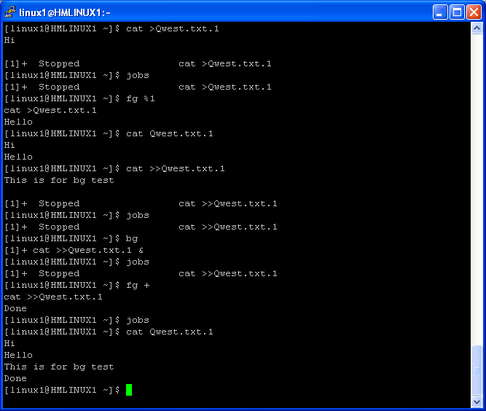
Example:

Slide 200
nohup,vmstat,iostat,prstat,top,sar,glance,nmon,time
nohup - run a command immune to hangups, with output to a non-tty
Syntax : nohup COMMAND
vmstat - Report virtual memory statistics
vmstat reports information about processes, memory, paging, block IO, traps, and cpu activity.
prstat - report active process statistics
iostat - Report Central Processing Unit (CPU) statistics and input/output statistics for devices and partitions.
top -The top program provides a dynamic real-time view of a running system. It can display system summary information as well as a list of tasks currently being managed by the kernel.
sar - system activity reporter
glance - GlancePlus system performance monitor for HP-UX
nmon - nmon is used by system admins and performance analyst to check the system health
time - time a simple command or give resource usage
Example : time ls
Another example :
$ time date
Tue Jan 26 18:27:58 IST 2010
real 0m0.002s
user 0m0.000s
sys 0m0.001s

Slide 201
pgrep,pkill ,pwdx
pgrep, pkill - look up or signal processes based on name and other attributes
Example :
pgrep -u root sshd
will only list the processes called sshd AND owned by root.
pgrep -u root,daemon
will list the processes owned by root OR daemon.
To kill all the processes of a user :
pkill -u username
To obtainthe process ID of sendmail:
pgrep -x -u root sendmail
pwdx: Prints process working directory

Slide 202
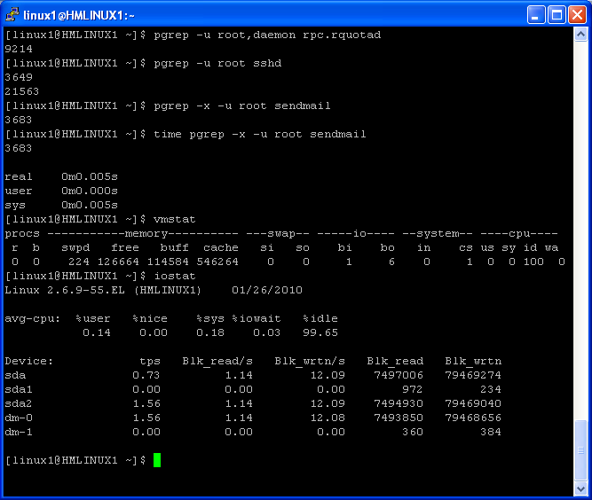
Example:

Slide 203
Questions ??
1)How to modify the scheduling priority ?
2)What is the default nice value ?
3)What is the highest priority value ?
4)What is the lowest priority value ?
5)How to get the process details of user Qwest using pgrep ?
6)How to kill all the processes of user Qwest using pkill ?
7)How to get the virtual memory statistics information ?
8)How to get the IO statistics information ?
9) What is the equivalent command for top ?
10) How to get the top n processes ?
11)How to get the working directory of a process ?
12) How many ways we can back ground a job ?
13) How to fore ground a job ?
14) How to get the pid of background jobs ?
15)Why nohup is required ?
16) What is the default output file for nohup ?
17)Syntax of nohup command ?
18) How to run a script in back ground ?
19) Suppose one job ( fore ground job) is running on your console. Now you want to make the job to run in back ground .What are the steps ?
20) What is the use of & ?
21) Will you able to kill a process owned by root ?

Slide 204
Job Scheduling
at
atq
atrm
batch
crontab
anacron
job schedulers
Control M
autosys

Slide 205
at,atq,atrm,batch
at executes commands at a specified time.
atq lists the userâs pending jobs, unless the user is the superuser; in that case, everybodyâs jobs are listed. The format of the output lines (one for each job) is: Job number, date, hour, job class.
atrm deletes jobs, identified by their job number.
batch executes commands when system load levels permit; in other words, when the load average drops below 0.8, or the value specified in the invocation of atrun.
Runs jobs when the system load level permits.
To run a job when the system load permits, enter:
batch <<EOF
JOBNAME
EOF
This example shows the use of a ″Here Document″ to send standard input to the batch command.

Slide 206
Example
1. To schedule the command from the terminal, enter a command similar to one of the following: If uuclean is in your current directory, enter:
at 5 pm Friday uuclean
<Ctrl-D>
at now next week uuclean
<Ctrl-D>
If uuclean is in $HOME/bin/uuclean, enter:
at now + 2 days $HOME/bin/uuclean
<Ctrl-D>
Note: When entering a command name as the last item on the command line, a full path name must be given if the command is not in the current directory, and the at command will not accept any arguments.
2. To run the uuclean command at 3:00 in the afternoon on the 24th of January, enter any one of the following commands:
echo uuclean | at 3:00 pm January 24
echo uuclean | at 3 pm Jan 24
echo uuclean | at 1500 jan 24
3. To have a job reschedule itself, invoke the at command from within the shell procedure by including code similar to the following within the shell file:
echo "ksh shellfile" | at now tomorrow
4. To list the jobs you have sent to be run later, enter:
at -l
5. To cancel a job, enter:
at -r ctw.635677200.a
This cancels job ctw.635677200.a. Use the at -l command to list the job numbers assigned to your jobs.

Slide 207
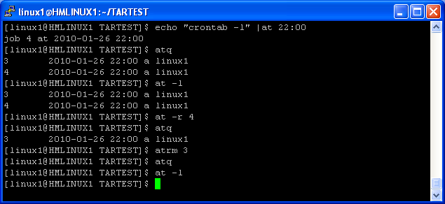
Example

Slide 208
crontab
crontab Submits, edits, lists, or removes cron jobs.
-l option causes the current crontab to be displayed on standard output.
-r option causes the current crontab to be removed.
-e option is used to edit the current crontab
The crontab File Entry Format:
A crontab file contains entries for each cron job.
Entries are separated by newline characters.
Each crontab file entry contains six fields separated by spaces or tabs in the following form:
minute hour day_of_month month weekday command
These fields accept the following values:
minute 0 through 59
hour 0 through 23
day_of_month 1 through 31
month 1 through 12
weekday 0 through 6 for Sunday through Saturday
command shell command(s)

Slide 209
Examples:
1. To copy a file called mycronjobs into the /var/spool/cron/crontabs directory, enter the following:
crontab mycronjobs
The file will be copied as: /var/spool/cron/crontabs/<username> where <username> is your current user name.
2. To write the time to the console every hour on the hour, enter:
0 * * * * echo The hour is `date` . >/dev/console
3. To run the calendar command at 6:30 a.m. every Monday, Wednesday, and Friday, enter:
30 6 * * 1,3,5 /usr/bin/calendar
4. To run the calendar command every day of the year at 6:30, enter the following:
30 6 * * * /usr/bin/calendar
5. To run a script called maintenance every day at midnight in August, enter the following:
0 0 * 8 * /u/harry/bin/maintenance
6. To define text for the standard input to a command, enter:
0 16 * 12 5 /usr/sbin/wall%HAPPY HOLIDAY!%Remember to
turn in your time card.
The text following the % (percent sign) defines the standard input to the wall command as: HAPPY HOLIDAY! Remember to turn in your time card.

Slide 210
Questions ??
1) Schedule to a job which will run only once at 22:00 ?
2) How to check the jobs present in “at queue” ?
3) How to remove a job from “at queue” ?
4) How to schedule a job using batch ?
5) Schedule a job “Clean” which will run every Sunday at 3:45 AM ?
6) Schedule a job “Clean” which will run every day at 12 :45:35 ?
7) Schedule a job “Clean” which will run on last day of every month ?
8) Schedule a job “Clean” which will run on last Sunday of every month ?
9) Schedule a job “Clean” which will run on 2nd Tuesday of every month ?
10)Schedule a job “Clean” which will run at 5:45 AM from every Mon-Fri ?
11)Schedule a job “Clean” which will run in every 30 minutes on sundays.
12)Schedule a job which will run on 1st of every month on 2010 and 2011 ?
13)How to check whether cron job is executed or not ?
14)If job did not run as per cron then what are the actions need to be taken ?
15)Will the schedule jobs run when the password for the user expired ?
16)Shcedule a job which will run only on Jan 3rd every year ?

Slide 211
Disk usage commands
df
du
bdf
quota
mount
umount
eject

Slide 212
Architecture of Unix File system
Formatted Disk
Partition1
Partition2
Partition3
File system
Directory1
Directory2
Directory3
Directory4
SubDir
SubDir
File1
File2
File3

Slide 213
df,bdf
df - report filesystem disk space usage
-a include filesystems having 0 blocks
-h print sizes in human readable format (e.g., 1K 234M 2G)
-k like --block-size=1K
-T print filesystem type
-i list inode information instead of block usage
bdf - report number of free disk blocks (Berkeley version)
-b Display information regarding file system swapping.
-i Report the number of used and free inodes.
-l Display information for local file systems only(HFS,CDFS etc).
-t type Report on the file systems of a given type (for example, nfs or hfs).

Slide 214
du,quota,mount,umount,eject
du - estimate file space usage
-a write counts for all files, not just directories
-b equivalent to --apparent-size --block-size=1
-h print sizes in human readable format (e.g., 1K 234M 2G)
-S do not include size of subdirectories
-s display only a total for each argument
-k like --block-size=1K
quota - display disk usage and limits
mount - mount a file system
any user can mount the iso9660 file system found on his CDROM using the command
mount /dev/cdrom or mount /cd
umount - unmount file systems
eject - eject removable media
eject –t With this option the drive is given a CD-ROM tray close command. Not all devices support this command.

Slide 215
Questions ??
How to check the file system use ?
How to check the disk use for a specific directory ?
How to check the file system use in kb/mb/gb ?
How to identify a local file system and a NFS file system ?
How to check the quota information for a specific user ?
What is bdf ?
How to get the mount points ?
How to get the details of “inodes used” and “inodes free” ?

Slide 216
Mailing commands/Utilities
- mail
- mailx
- uuencode
- sendmail
- pine

Slide 217
mail
mail - send and receive mail
-s Specify subject on command line (only the first argument after the -s flag is used as a subject; be careful to quote subjects containing spaces.)
-c Send carbon copies to list of users.
-b Send blind carbon copies to list. List should be a comma-separated list of names.
Example: To send mail to subhasis@Qwest.com
$echo “This is the body of the email” |mail –s “This is a test email” subhasis@Qwest.com
$cat mailbody.txt|mail –s “This is a test email” subhasis@Qwest.com
To send an attachment . Let the file is /tmp/sendit.doc
$uuencode /tmp/sendit.doc sendit.doc |mail –s “Document is aatched” subhasis@Qwest.com

Slide 218
mailx
mailx - mailx - interactive message processing system
-s subject Set the Subject header field to subject. subject should be enclosed in quotes if it
contains embedded white space.
-b bcc Set the blind carbon copy list to bcc. Bcc should be enclosed in quotes if it contains
more than one name.
-c cc Set the carbon copy list to cc. cc should be enclosed in quotes if it contains more than
one name.
Example: To send mail to subhasis@Qwest.com
$echo “This is the body of the email” |mailx –s “This is a test email” subhasis@Qwest.com
$cat mailbody.txt|mailx –s “This is a test email” subhasis@Qwest.com
To send an attachment . Let the file is /tmp/sendit.doc
$uuencode /tmp/sendit.doc sendit.doc |mailx –s “Document is aatched” subhasis@Qwest.com
To send mail with attachment and message body :
( cat body.txt
uuencode pic.jpg pic.jpg
) | mailx -s "subject" subhasis@Qwest.com

Slide 219
sendmail
MAILTO="subhasis@Qwest.com"
MAILFROM=" subhasis@Qwest.com "
echo 'Subject: *** DirB Statistics ***
From: '$MAILFROM'
To: '$MAILTO'
Daily Processing Details
-------------------------------------------------------
Eastern Reads :$Eastern
Western Reads :$Western
Central Reads :$Central
Total Reads :$TOTAL
-------------------------------------------------------
Thanks ,
Subhasis
'| /usr/sbin/sendmail $MAILTO

Slide 220
Questions ??
How to send an email using mail ?
How send an email using mailx ?
How to send an email using sendmail ?
How to send an email with attachment ?
How to send an email with attachment and message body ?

Slide 221
Networking commands
ifconfig
netstat
ping
ipcs
ipcrm

Slide 222
Ifconfig,netstat,ping,ipcs,ipcrm
ifconfig - configure a network interface / to check the ip address for interfaces
netstat - Print network connections, routing tables, interface statistics, masquerade connections, and multicast memberships
-a, --all Show both listening and non-listening sockets.
ping - This command is used to check the network resources (hosts) are alive or not ?
ipcs - provide information on ipc facilities
-m shared memory segments
-q message queues
-s semaphore arrays
-a all (this is the default)
ipcrm - remove a message queue, semaphore set or shared memory id
-M shmkey removes the shared memory segment created with shmkey after the last detach is performed.
-m shmid removes the shared memory segment identified by shmid after the last detach is performed.
-Q msgkey removes the message queue created with msgkey.
-q msgid removes the message queue identified by msgid.
-S semkey removes the semaphore created with semkey.
-s semid removes the semaphore identified by semid.

Slide 223
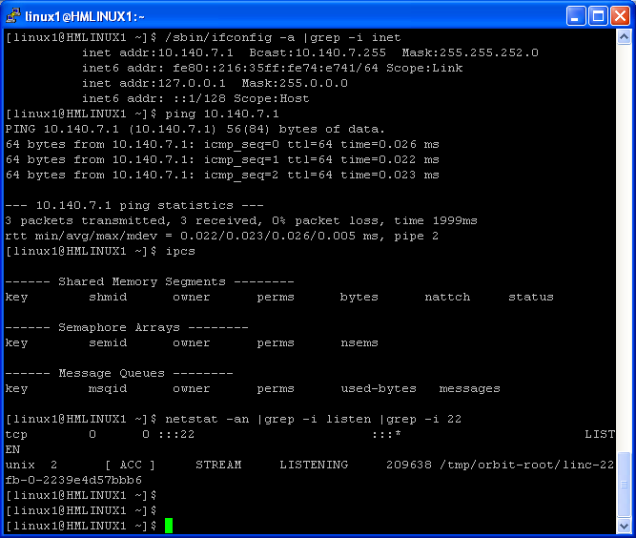
Example:

Slide 224
Questions ??
How to check the IP addresses of system ?
How to get the IP address using lanscan ?
How to check whether a port is listening or not ?
What is the purpose of ipcs command ?
What is the purpose of ipcrm command ?
How to check whether a server is available in net work or not ?

Slide 225
Printing commands
lp/lpr - submit a print job
lpstat/lpq - check the status of a print job
cancel/lprm - cancel a print job
pr - prepare files for printing

Slide 226
lp/lpr - submit a print job
lp and lpr submit the specified file, or standard input, to the printer daemon to be printed. Each job is
given a unique request-id that can be used to follow or cancel the job while it’s in the queue.
Syntax
lp [options] filename
lpr [options] filename
Common Options:
lp lpr function
---------------------------------------------------------------------------------------------
-n number -#number number of copies
-t title -Ttitle title for job
-d destination -Pprinter printer name
-c (default) copy file to queue before printing
(default) -s don’t copy file to queue before printing
-o option additional options, e.g. nobanner

Slide 227
lpstat/lpq - check the status of a print job
You can check the status of your print job with lpstat or lpq.
Syntax
lpstat [options]
lpq [options] [job#] [username]
Common Options
lpstat lpq function
-d (defaults to lp) list system default destination
-s summarize print status
-t print all status information
-u [login-ID-list] user list
-v list printers known to the system
-p printer_dest -Pprinter_dest list status of printer, printer_dest

Slide 228
cancel/lprm - cancel a print job
Any user can cancel only heir own print jobs.
Syntax
cancel [request-ID] [printer]
lprm [options] [job#] [username]
Common Options
cancel lprm function
-Pprinter specify printer
- all jobs for user
-u [login-ID-list] user list

Slide 229
pr - prepare files for printing
pr prints header and trailer information surrounding the formatted file. You can specify the number of pages, lines per page, columns, line spacing, page width, etc. to print, along with header and trailer information and how to treat <tab> characters.
Syntax
pr [options] file
Common Options :
+page_number start printing with page page_number of the formatted input file
-column number of columns
-a modify -column option to fill columns in round-robin order
-d double spacing
-e[char][gap] tab spacing
-h header_string header for each page
-l lines lines per page
-t don’t print the header and trailer on each page
-w width width of page

Slide 230
Questions ??
How to submit a job to a printer ?
How to check the status of print jobs ?
How to check how many jobs are present in the printer queue ?
How to remove or cancel a job from printer queue ?

Slide 231
Arithmetic operations
bc
expr
(( ))

Slide 232
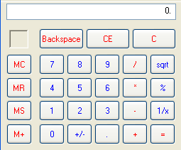
bc
Binary Calculator for Unix.
$bc
12 + 5
17
^d
$
$bc
12 - 5
7
^d
$
$bc
12*5
60
^d
$
$bc
20/5
4
^d
$
$bc
2^3
8
^d
$
Addition
Subtraction
Multiplication
Division
Exponential

Slide 233
Scale:-
By default, bc performs truncated division.One have to set scale to the number of digits of precision before performing any division.
$bc
scale=2
10/4
2.50
^d
$
If answer to division is greater than the value as dictated by the scale variable, then the value dictated by the scale is ignored and the real value is shown.

Slide 234
ibase and obase:-
By default, the input and output are interpreted as decimal values.But, if the demand required input and/or output in different number system(binary, hexadecimal), variables ibase and obase are set.
To convert binary input to decimal output:-
ibase=2
To convert decimal input(default) into binary output:-
obase=2
For hexadecimal systems, value ’16’ is used in ibase/obase variable.

Slide 235
Handling Variables:-
Variables can be used in bc mode and values can be assigned to them.
$bc
X=12 ; y=19
Z=x+y
Z
31
Conditional logics(if) ,loops(for,while), arrays, functions are supported by ‘bc’

Slide 236
Square Root of a Number
Syntax : sqrt ( x )
Example :
$bc
Sqrt ( 4 )
2
Length of a Number
Syntax : length ( x )
Example :
$bc
length ( 1234.5678 )
8

Slide 237
Trigonometric Functions
To use trigonometric functions of bc, one have to include math library. For that , issue the following command from Os prompt:-
$ bc –l
Various trigonometric functions available with ‘bc’ are:-
s(x) sine
c(x) cosine
e(x) exponential
l(x) log

Slide 238
expr
Allows to perform calculations and handle strings
Calculations
$expr 100 + 50
150
$expr 100 – 50
50
$expr 100 \ * 2
200
$expr 12 / 3
4
$expr 12 % 5
2
$z=`expr 100 – 50`
50

Slide 239
String handling
To find length of a string:-
expr “<string>” : ‘.*’
Example : $ expr “Unix” : ‘.*’
4
To extract a substring from a string:-
$ expr “Qwest” : ‘… (\..\)’
st # Shows 4th to 5th character
To locate first position of a character in a string:-
$expr “Nithin” : ‘[^d]*h’
4 # Shows ‘h’ is at 4th position

Slide 240
factor
Finds out factor of the integer provided
Syntax : factor <number>
$factor 15
15
3
5
$
$factor 18
18
2
3
3
$

Slide 241
primes
Shows all prime numbers between integers <lower value> and <upper value>. If upper value is not provided, it is considered to be 2,147,483,647.
Syntax : primes <lower value> <upper value>
$primes 0 10
2
3
5
7
$

Slide 242
units
Converts quantities expressed in various standard scales to their equivalents in other scales. Acts interactively as follows:-
System Prompt User Response
You have: inch
You want: cm
The system responds with two factors; one used if multiplying (preceded by *), the other if dividing (preceded by /):
* 2.540000e+00
/ 3.937008e-01
For a complete list of units, examine the file:
/usr/share/lib/unittab

Slide 243
Use (( ))
$ A=5;B=12
$ echo $(( A + B ))
17
$ echo $(( $A + $B ))
17
$ ( echo scale=3 ;echo 5 / 2 )|bc
2.500
$ echo "2.3 + 4.5" |bc
6.8
$ echo "5.0 / 2.1" |bc
2
$ ( echo scale=3 ;echo 5.0 / 2.1 )|bc
2.380
$ expr 2.3 + 4.5
expr: non-numeric argument
$ expr 2 + 4
6

Slide 244
Questions ??
How to perform arithmetic operations using bc ? Give some examples ?
How to perform arithmetic operations using expr ?
How to perform arithmetic operations using (( )) ?
How to add 2 floating point numbers ?

Slide 245
Useful commands:
- telnet
- ssh
- scp
- sftp
- ftp
- Automate SSH login using public key .
- rlogin
- remsh
- sum
- cksum

Slide 246
Useful commands:
telnet - user interface to the TELNET protocol
ssh - OpenSSH SSH client (remote login program)
scp - secure copy (remote file copy program)
sftp - secure file transfer program
ftp - file transfer program
- Automate SSH login using public key .
rlogin - remote login
remsh, rexec - execute from a remote shell
sum - checksum and count the blocks in a file
Example : sum filename
cksum - checksum and count the bytes in a file
Example : cksum filename

Slide 247
Questions ???
How confirm that file transfer is successful ?
Explain the use of cksum command ?
What is the difference between sum and cksum ?
How to tranfer a file in ascii mode ?
What is the syntax of scp command ?
How to automate ssh login to different server ?
What is remsh ?

Slide 248
Misc commands :
-getent
-useradd
-userdel
-usermod
-groupadd
-groupdel
-groupmod
-chage
-basename
-which
-whatis
-whereis
-alias
-man
-info
-history
-file
-type
-script
-tee
-pstree
-shutdown
-poweroff
-reboot

Slide 249
Misc commands :
getent - get entries from administrative database
database is the name of the database to be examined. This can be passwd, group, hosts, ipnodes, services, protocols, ethers, project, networks, or netmasks.
Example : getent passwd username
useradd - Create a new user or update default new user information
Example : useradd subhasis
userdel - Delete a user account and related files
Example : userdel subhasis
usermod - Modify a user account
groupadd - Create a new group
groupdel - Delete a group
groupmod - Modify a group

Slide 250
Misc commands :
chage - change user password expiry information
Example: chage –l linux1
basename - strip directory and suffix from filenames-which
Example : echo “/A/B/C/D” |xargs basename
whatis - search the whatis database for complete words.
Example : whatis ls
whereis - locate the binary, source, and manual page files for a command
Example : whereis ifconfig
which - shows the full path of (shell) commands.
Example : which ls
alias - To create alias
Example : alias prg=“cd /home/user/projects/prg”

Slide 251
Misc commands :
man - To check the man page
info - read Info documents
history – To check the previous comands executed in the console
file - determine file type
Example : file Qwest.gz
type - write a description of command type
Example : type ls

Slide 252
Misc commands :
script - make typescript of terminal session
After starting the scripting, user continues with his job. All the commands he uses, their output and error messages are stored for later view.
When the user exits from the scripting(writing : exit from OS prompt), the script file is saved and a message is shown:-
Script done, file is typescript
script -a Append the output to file
tee - replicate the standard output
Example : ls –l |tee ls.out
pstree - display a tree of processes
shutdown - bring the system down
halt, reboot, poweroff - stop the system.

Slide 253
tput : Controls screen display
Options | Significance
tput clear | Clears the screen
tput cup <r> <c> | Moves cursor to row <r> and column <c>
tput bold | Bold display
tput blink | Blink display
tput rev | Reverse display
tput cols | Shows number of columns in the screen
tput bel | Echo bell character
tput lines | Shows number of lines in the screen
tput smso | Starts reverse display
tput rmso | Ends reverse display

Slide 254
Commands | Significance
ls –t | Sorts files by modification time – the file modified most recently comes at the top
ls –ut | Sorts files by access time
ls –r | Sorts file in reverse order
ls –ltr | Shows long listing of files with their attributes, sorted in reverse order by access time(most recently edited file comes last in the list)
ls –i | Shows inode number of a file
ls *.ksh | Shows the name of all files with ‘.ksh’ at the end of their name
ls [aeiou]* | Shows the files with name starting with vowels
ls d*.sh | Lists all files starting with ‘d’ and ending with ‘.sh’ in their name
ls d?l* | Lists all files with first letter as ‘d’ and third letter as ‘l’
ls [!aeiou]* | Shows the files with names not starting with vowels

Slide 255
Thank You !!!!
Any Questions Mail me ☺
Subhasis.samantaray@centurylink.com subhasis.samantaray@gmail.com

